Slide 1

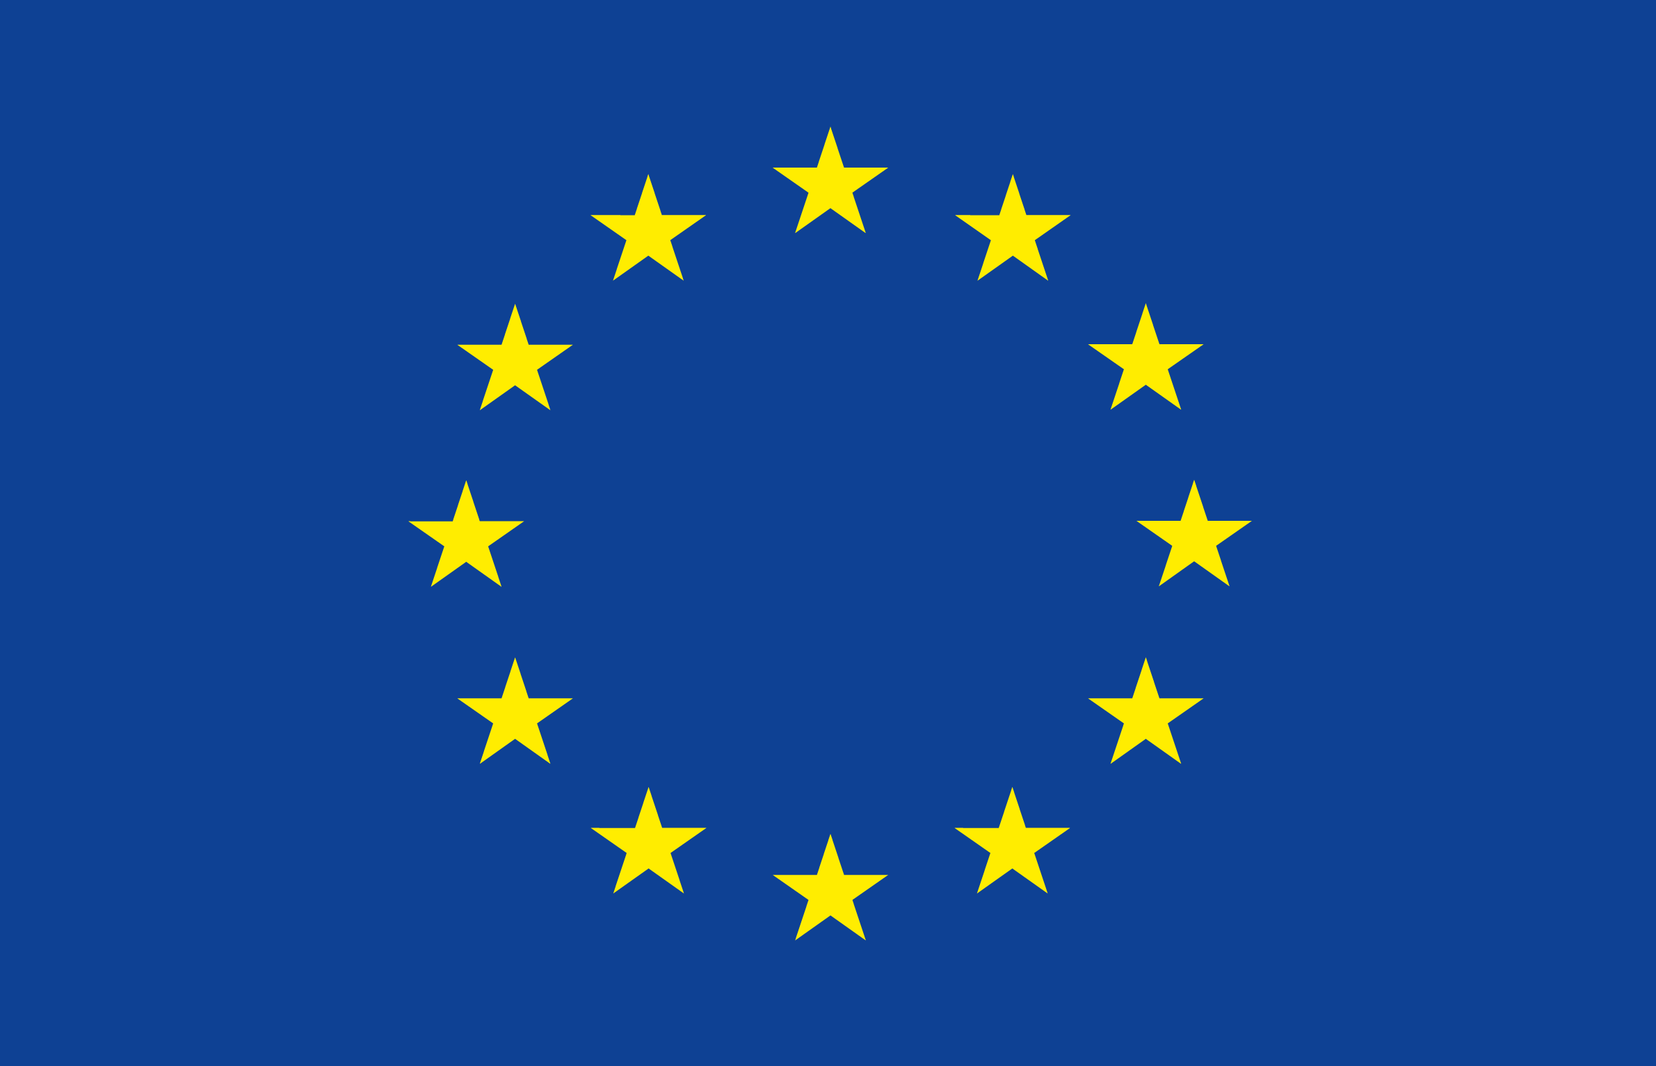
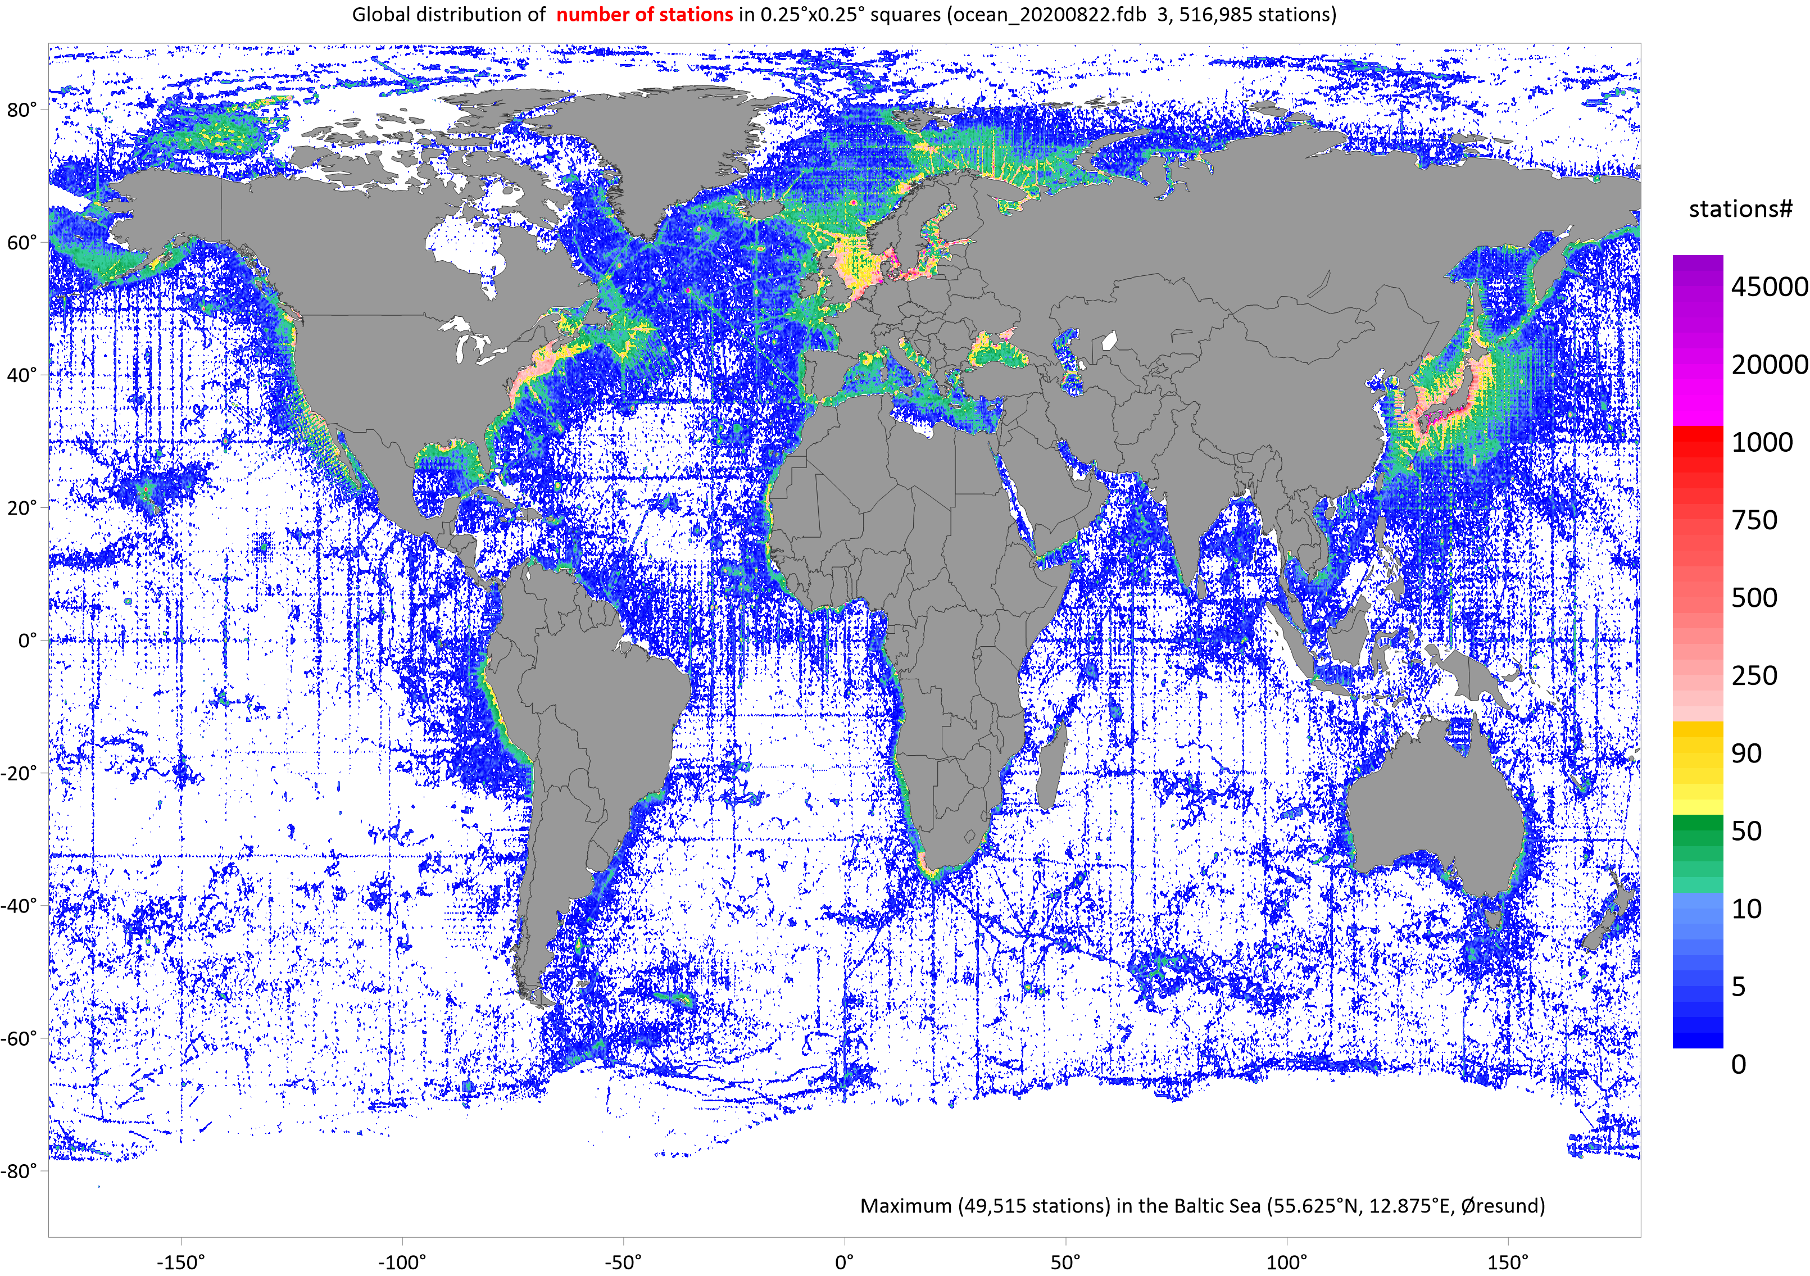


Alexander Korablev, Are Olsen
Progress with geochemistry dataset compilation for the EU 2020 project COMFORT
COMFORT annual meeting 2-3.09.2020

Slide 2

Workflow
Output: | source datasets |  | source databases | QC source databases |  | merged database |  | inversion matrix | adjusted database |  | Product
Action: DS Priority | SDSs collection | conversion into DB format | primary QC |  | merging with duplicate control | secondary quality control |  |  | Expert control and data adjustment |  | Data upload in exchange formats
 |  |  |  |  |  | crossover analysis |  | inversion analysis
GLODAP Partners ITP Russian data NABOS ICES ARGO IQuOD WOD18 | Reference SDS-1 SDS-N | ----> ----> ----> | No DB-1 DB-N | DB-1^{QC} DB-N^{QC} | ----> ----> Priority for the first-hand datasets ----> | RDS |  |  | RDS |  | COMFORT dataset for distribution and analysis
 |  |  |  |  |  | DS-1^{QDC} |  |  | DS-2^{QDCA}
 |  |  |  |  |  | DS-2^{QDC} |  |  | DS-2^{QDCA}
 |  |  |  |  |  | DS-N^{QDC} |  |  | DS-2^{QDCA}
QF: | iDS_QF |  | +pQC_QF |  |  |  |  | +sQC_QF |  |  | WOCE_QF
Format: | different |  | DB | DB |  | DB |  |  | DB |  | WOCE,netCDF..
Core variables: | salinity, oxygen, nitrate, silicate, phosphate, dissolved inorganic carbon, total alkalinity, pH, CFC-11, CFC-12, CFC-113, and CCl4
Data use statement: | The row data submitted to the project are in the public domain if three years have passed after the measurements. Before this deadline they are available in agreement with the principal investigator.

Slide 3
Data sources
WOD / ICES/ IQuOD ?
Original units ?
GLODAP The Global Ocean Data Analysis Project (GLODAPv2.2019) https://www.nodc.noaa.gov/ocads/oceans/GLODAPv2_2019/
ITP Ice-Tethered Profiler https://www.whoi.edu/page.do?pid=20756
GODAR Global Oceanographic Data Archaeology and Rescue https://www.nodc.noaa.gov/about/international_godar.html
ARGO http://www.argodatamgt.org/Access-to-data/Argo-DOI-Digital-Object-Identifier
WOD18 WORLD OCEAN DATABASE 2018 https://www.nodc.noaa.gov/OC5/WOD/pr_wod.html
OCADS Ocean Carbon Data System https://www.nodc.noaa.gov/ocads/
PANGAEA https://www.pangaea.de/
NABOS Nansen and Amundsen Basins Observational System https://uaf-iarc.org/nabos-cruises/
OMG Ocean Melting Greenland https://omg.jpl.nasa.gov/portal/
NERSC https://www.nersc.no/news/unique-oceanographic-observations-jotun-arctic-survey-east-greenland-fjord

Slide 4
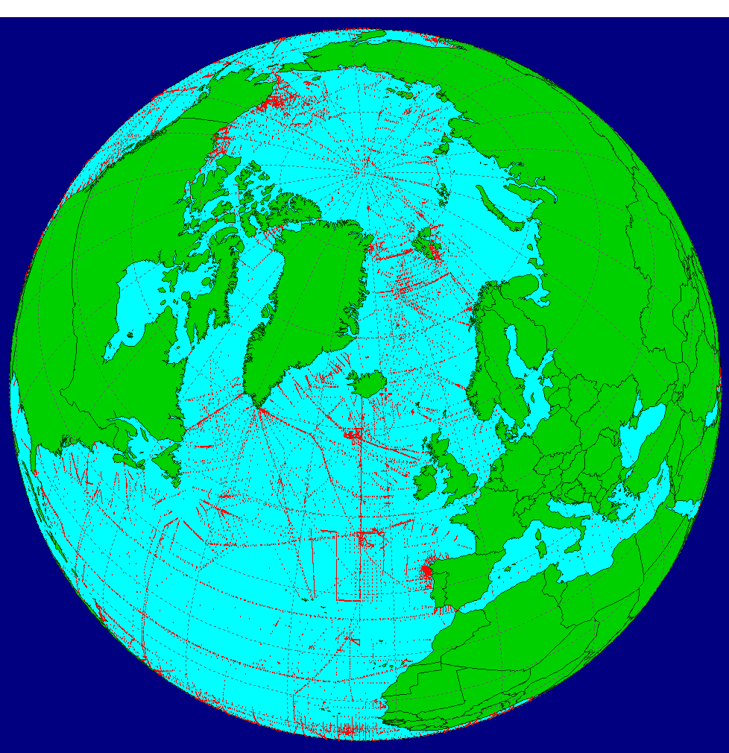
GLODAP v2.2019 product
Comparison with WOD18
Variable samples# (%)
TEMPERATURE 1165742 (4.2%)
SALINITY 1144575 (4.4%)
OXYGEN 1006881 (10.3%)
PHOSPHATE 845687 (15.6%)
SILICATE 896657 (21.4%)
NITRATE 90204 (26.4%)
PHTS25P0 234067 (9.2%)
PHTSINSITUTP 210971 (8.3%)
TALK 370915 (53.4%)
CHLA 42861 (3.46%)
TCO2 422177
H3 30922 (105.4%)
HE 38683 (94.9%)
HE3 42356 (81.6%)
C14 40236 (119.3%)
NEON 25536 (94.9%)
CFC11 354670 (97.7%)
CFC12 359186 (99.1%)
CFC113 110660 (81.2%)
O18 12320 (110.2%)
---------------------------------
NITRITE 685121
SF6 73947
CC14 43112
PCFC11 347202
PCFC12 351788
PCFC113 108942
PCC14 40382
PSF6 73737
DOC 53506
DON 1672
TDN 29772
TOC 3084
REFERENCE
DATASET
Cruises & DS: 840
GLODAP Stations: 52315
Stations: 59116
Profiles/casts: 58359 (t)
58280 (s)
48776 (o2)
12162 (ph)
10617 (ph)
24.07.1972 – 22.02.2017
Data type: bottle
Total samples: 11,096,437
13.1% WOD
GLODAPv2.2020
+ 106 cruises
until 2019
Are Olsen et al., 2020

Slide 5
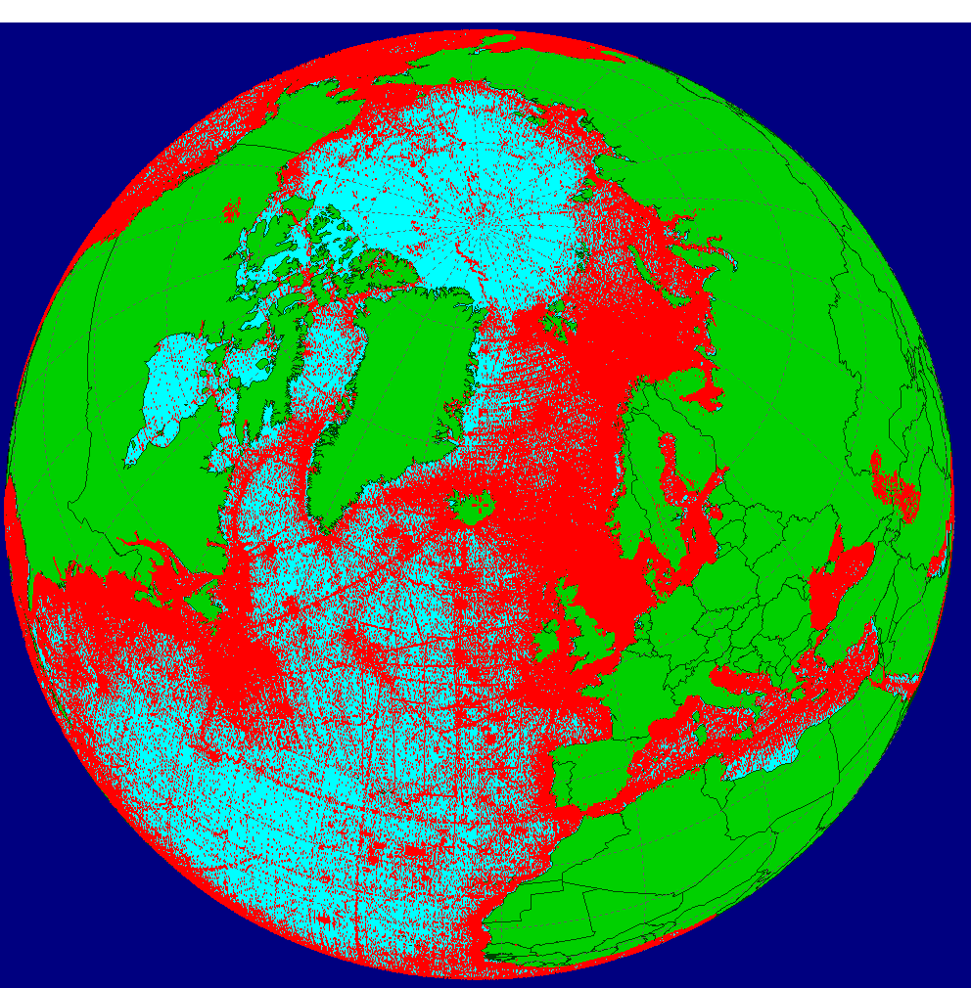
WOD18
Variable(23) samples
TEMPERATURE 27559147
SALINITY 25606424
OXYGEN 9745229
PHOSPHATE 5414742
SILICATE 4187283
NITRATE 3416143
PH 2552826
ALK 694610
TCHL 1236860
PCO2 36392
H3 29333
HE 40731
HE3 34562
C14 33738
NEON 26900
CFC11 362832
CFC12 362400
CFC113 136221
O18 11183
---------------------------------
ARGON 2077
PCO2 36392
DIC 389171
WPRES 2710195
COMBINED
DATASET
Cruises: 215,799
Stations: 3230404
Profiles: 2945951 (t)
2468594 (s)
960681 (o2)
297604 (ph)
15.12.1772 – 5.02.2019
Data type: OSD
Total samples: 84,620,368

Slide 6
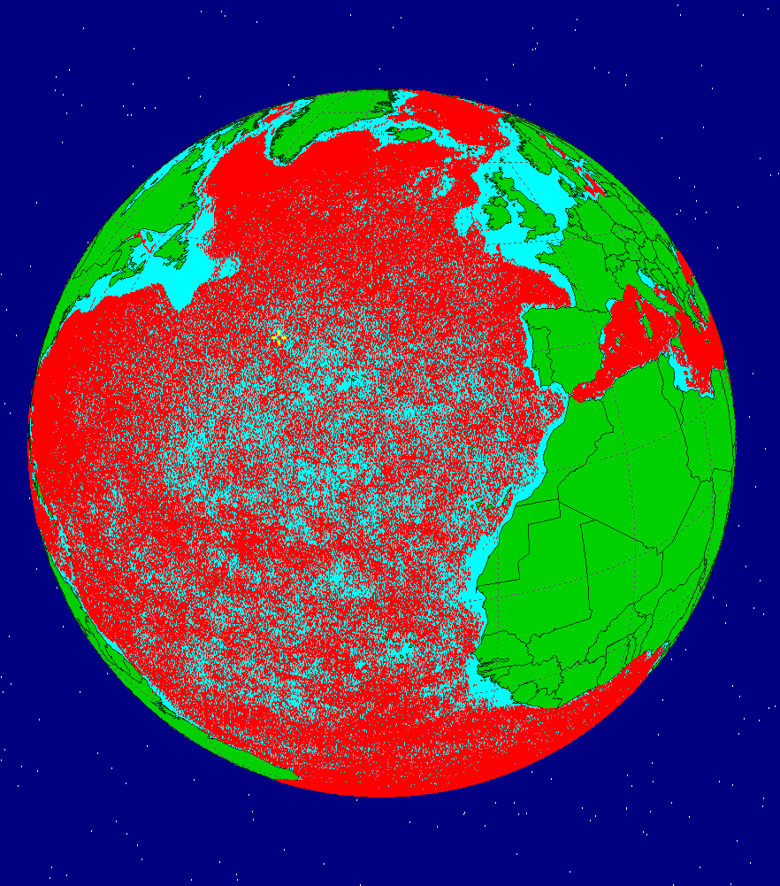
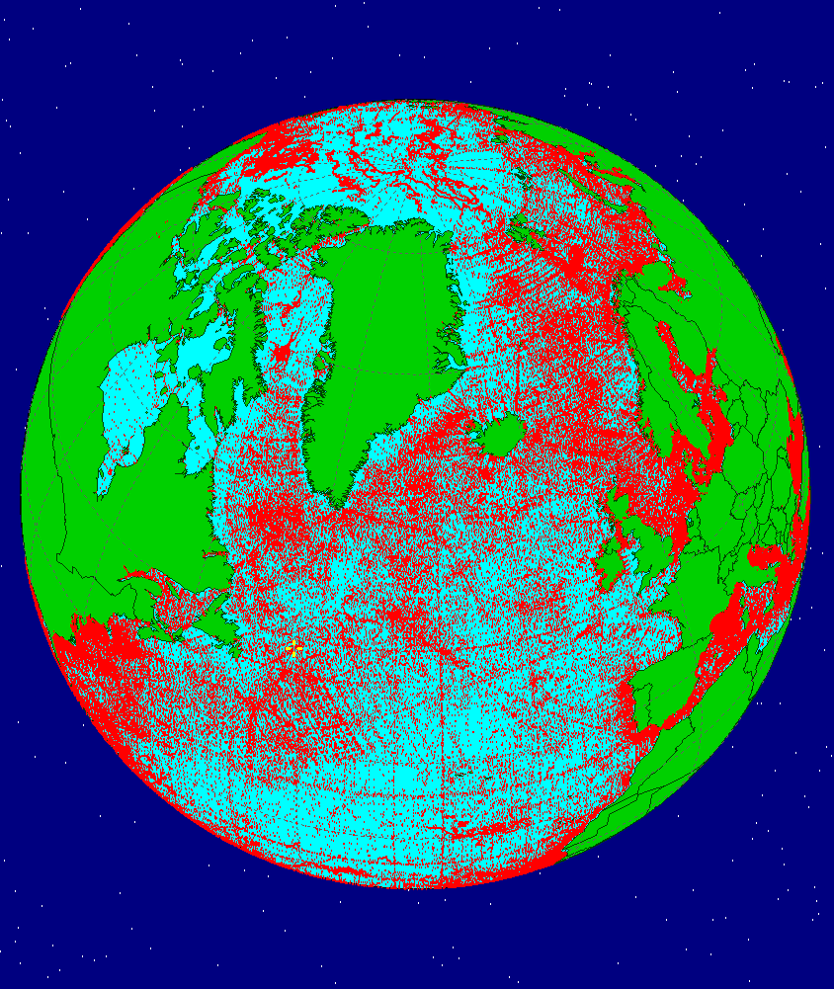
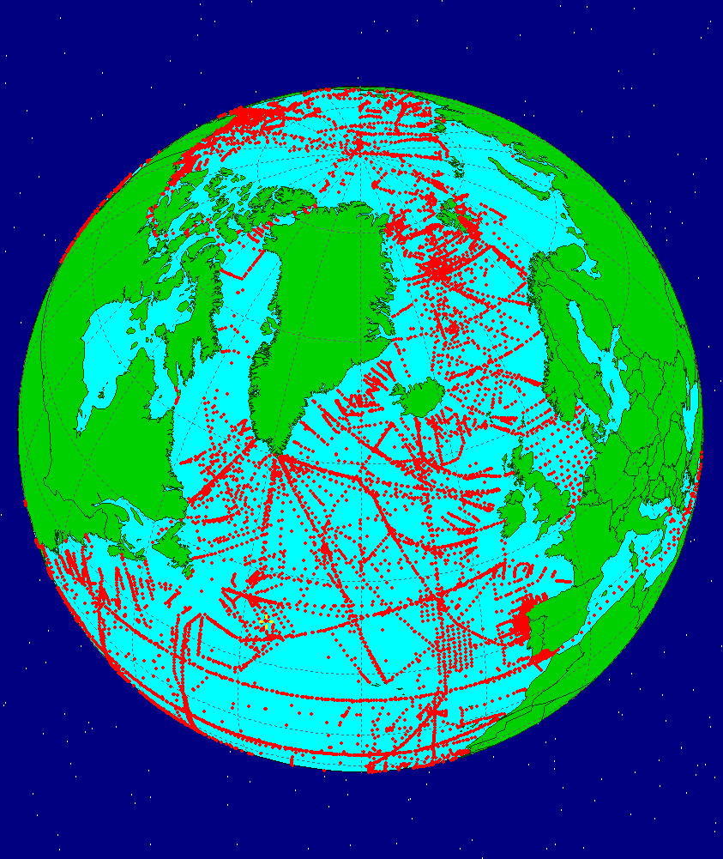
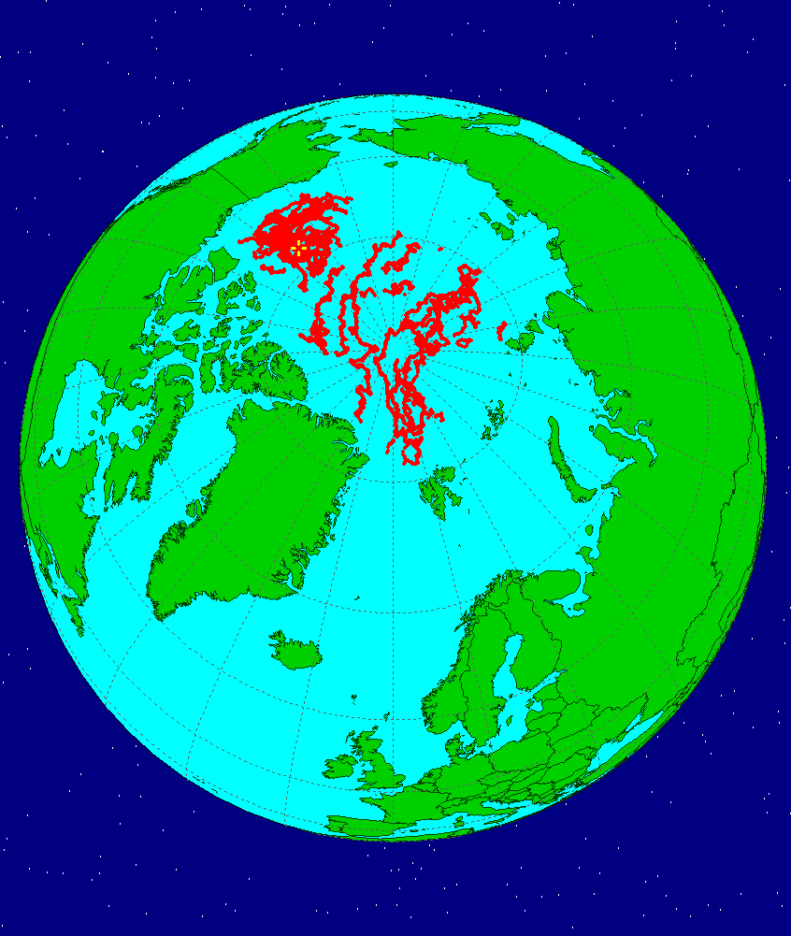
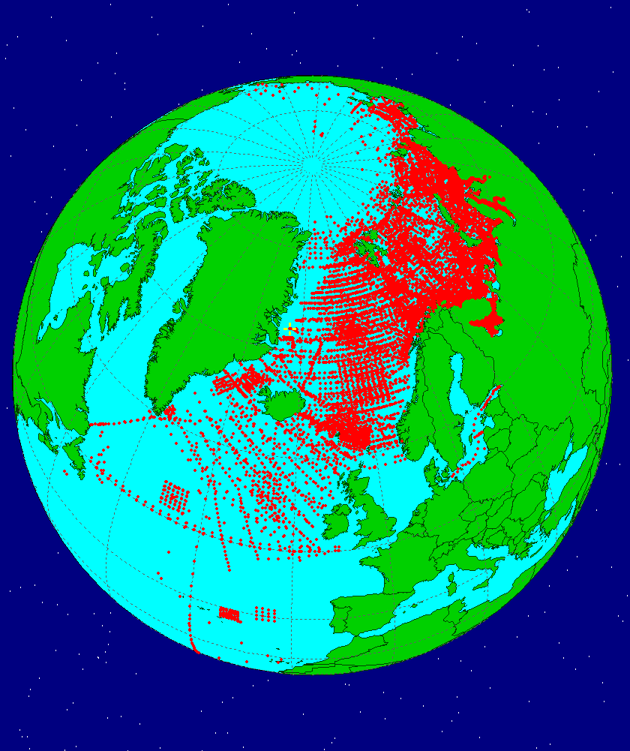
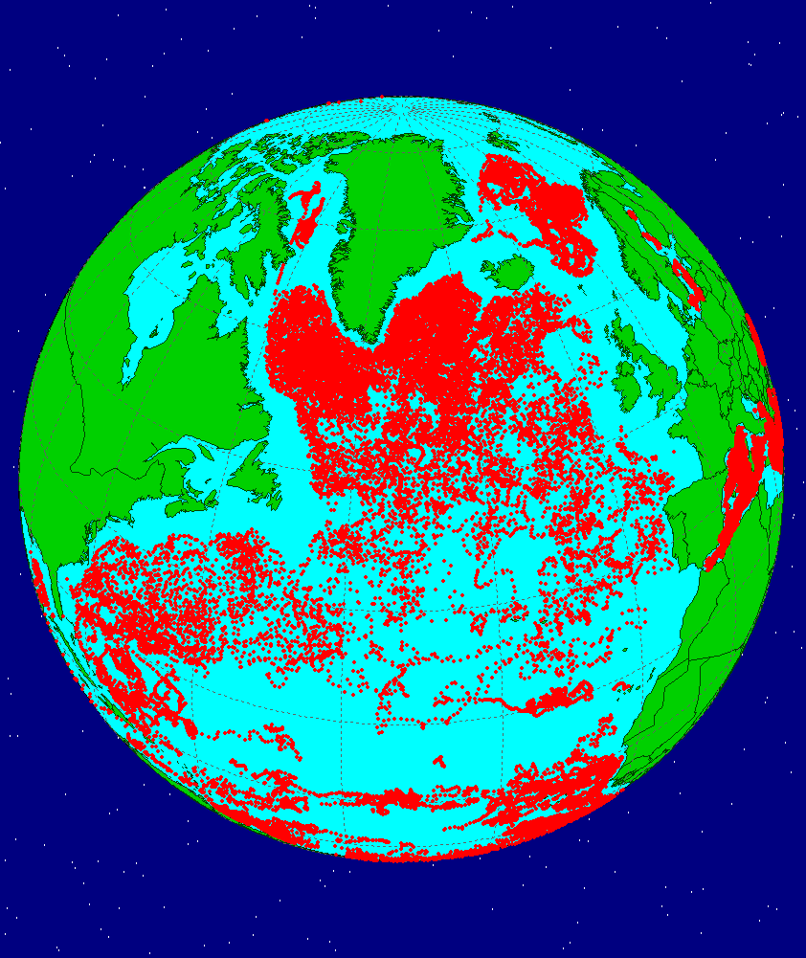
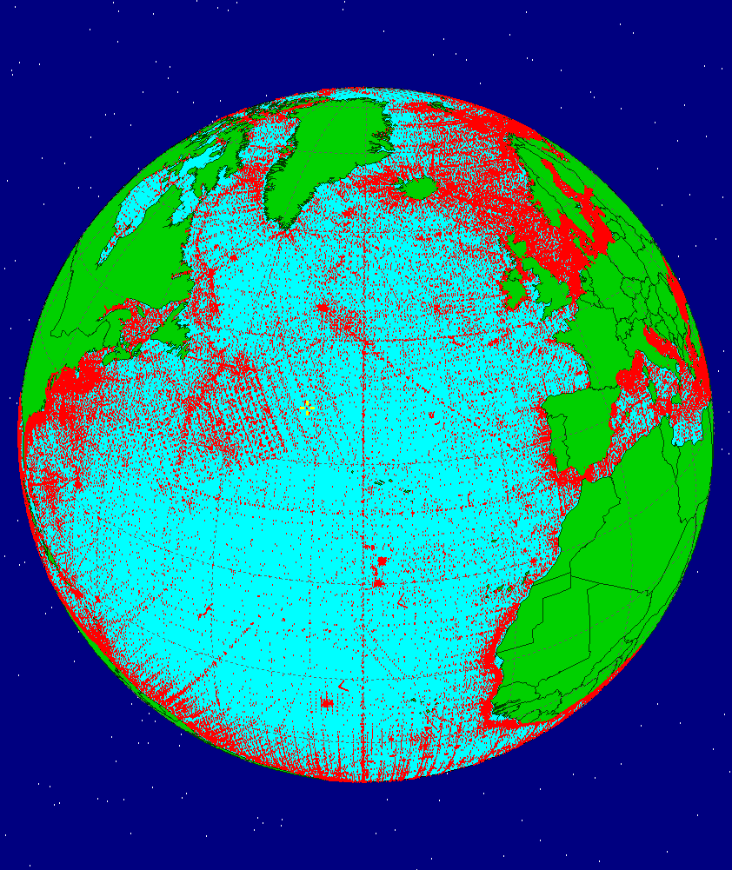
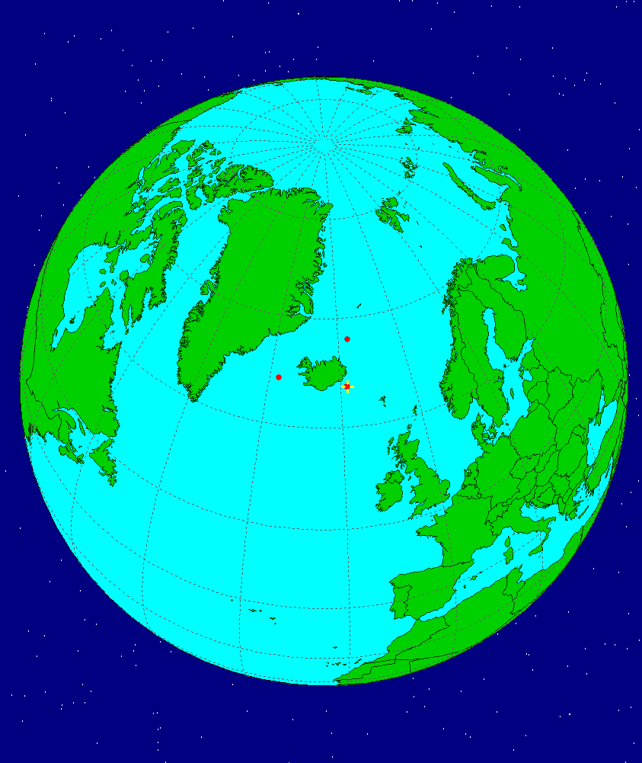
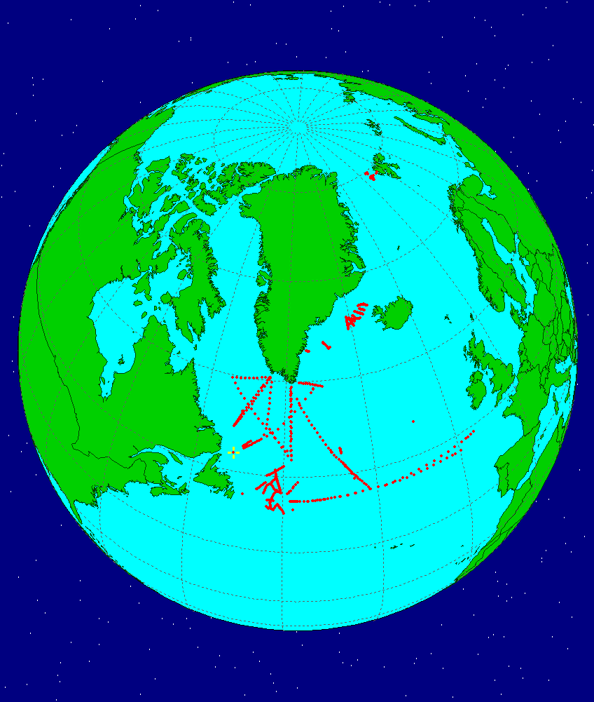
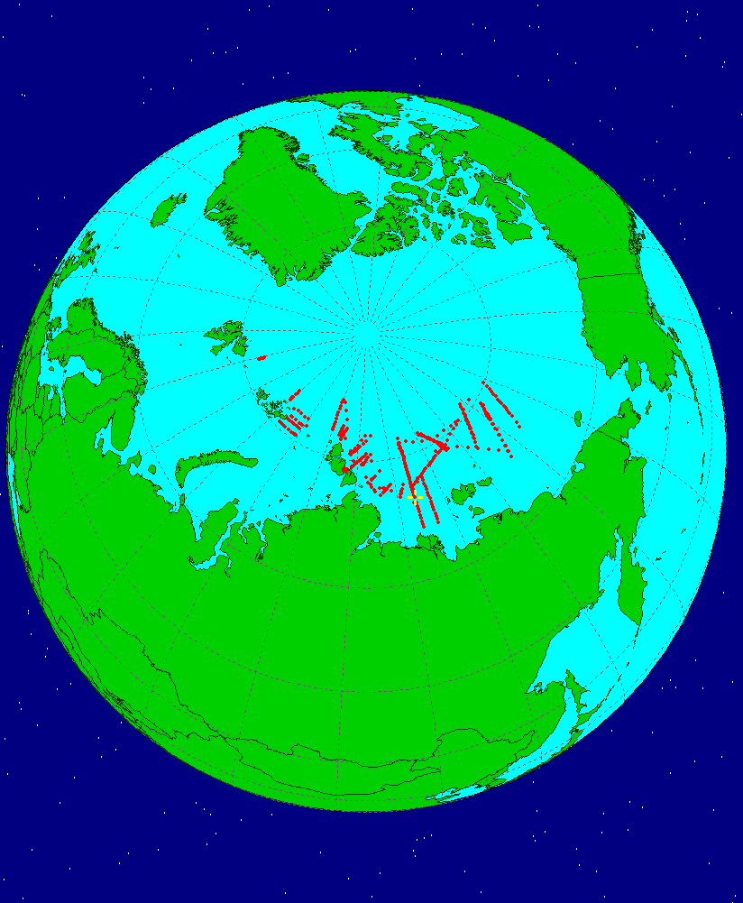
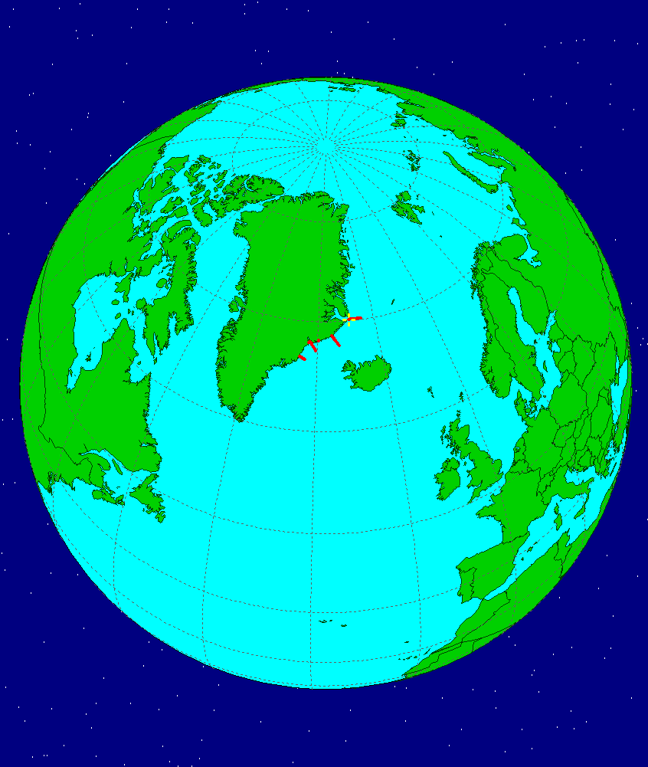
Features of the datasets
(e.g. datasets with oxygen)
ARGO
Core and B-profiles
OCEAN
GLODAP
ITP
GODAR
BGS-ARGO
Synthetic-profiles data
WOD18
OCADS
PANGAEA
NABOS
NERSC
Spatial coverage
Temporal resolution
Vertical resolution
Composition of variables
Accuracy of measurements
Degree of quality control
Presence of duplicates

Slide 7
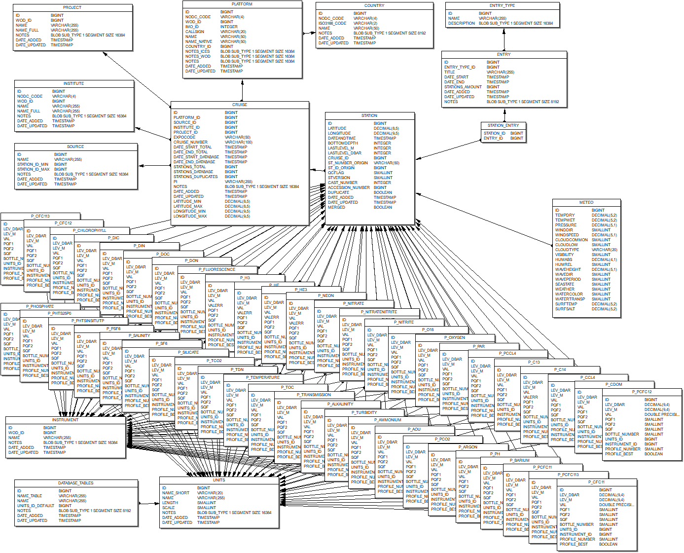
Database/processing software
Basic principles
Cruise-based database organization -> secondary quality control (QC)
Original datasets have priority -> no duplicates / original units
Different ID ranges for datasets -> easy search and update
Original units -> compatibility with datasets
Units recomputing on the fly -> uniform conversion algorithms
Each observation has three different QC flags assigned (from source, internal, secondary)
Each observation has instrument and unit indexes assigned
Internal graphic for QC -> simplifies expert control
Profiles numbering system -> allows profiles comparison ( incl. diff. instruments) and the best profile selection for calculations at a station
Duplicates are stored in the merged database -> allows to combine data and metadata
Embedded modules for QC and data analysis
Includes a ‘knowledge’ database’ -> identification of sources, platforms, projects, institutes, countries
Data catalogue (Entry) -> flexible system for creating data subsets
Data export -> considering QC flags, duplicates, change of profiles vertical resolution
Database design

Slide 8
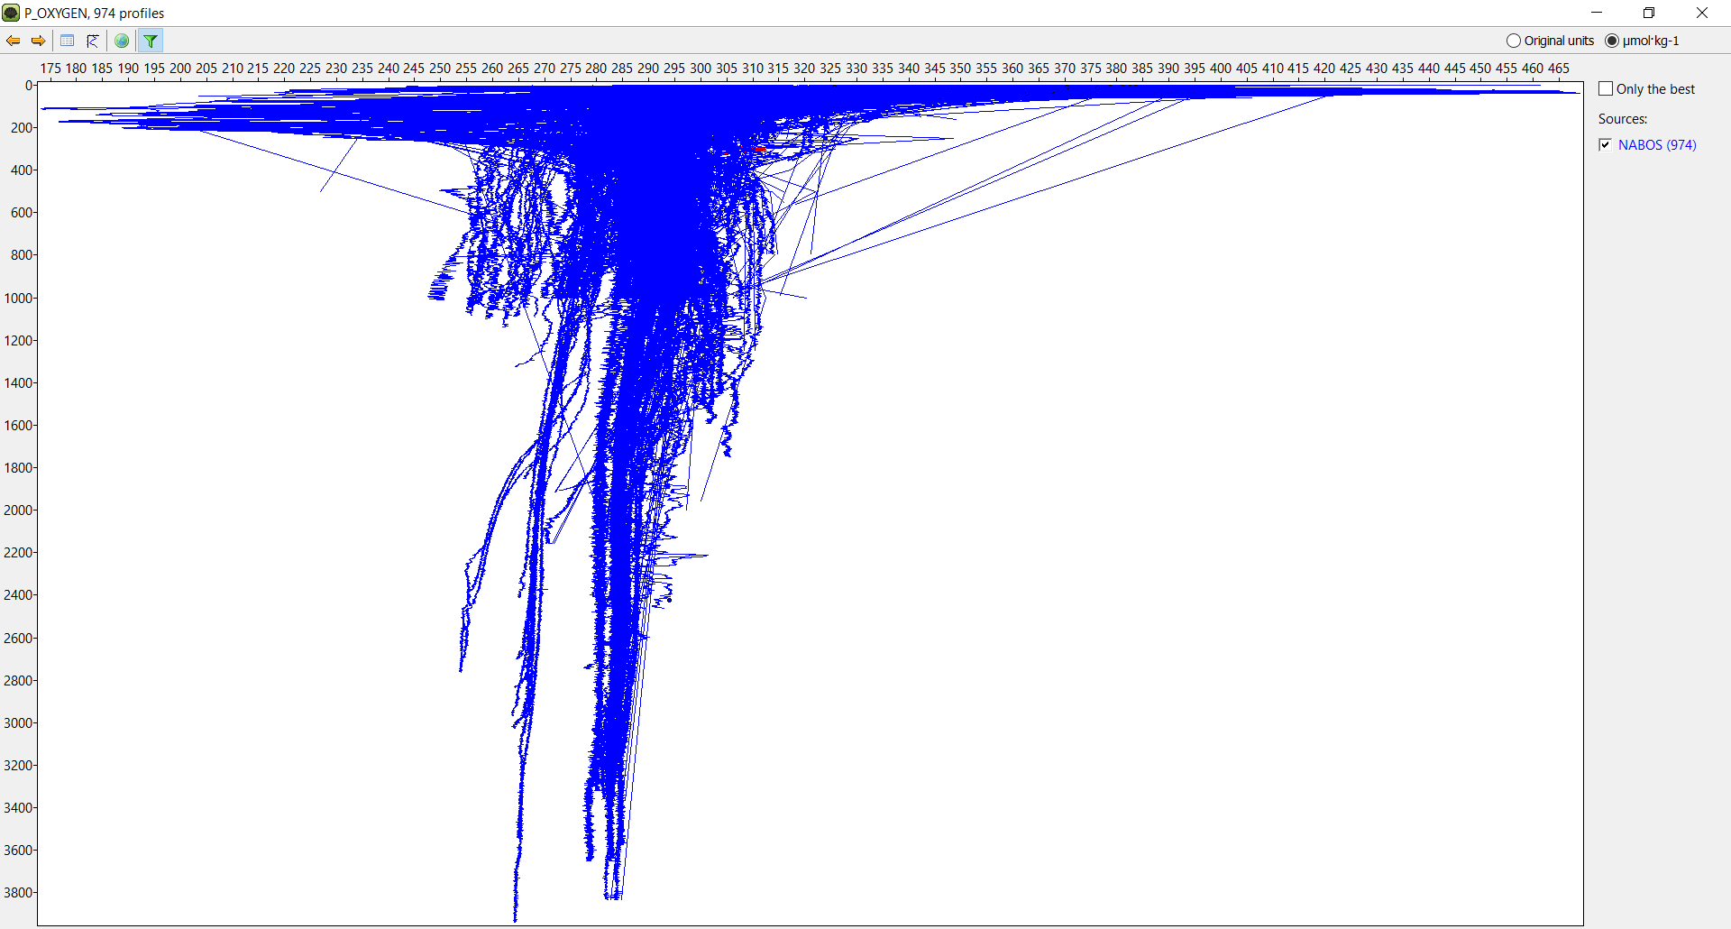
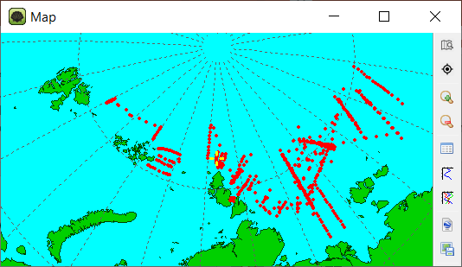
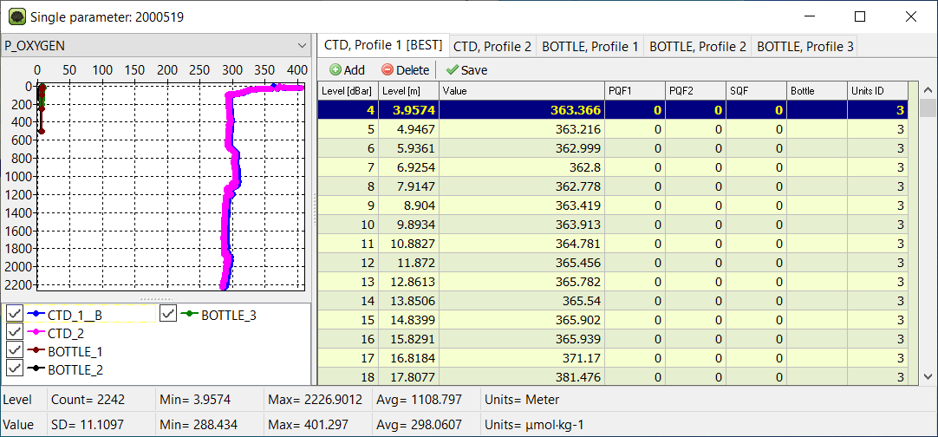
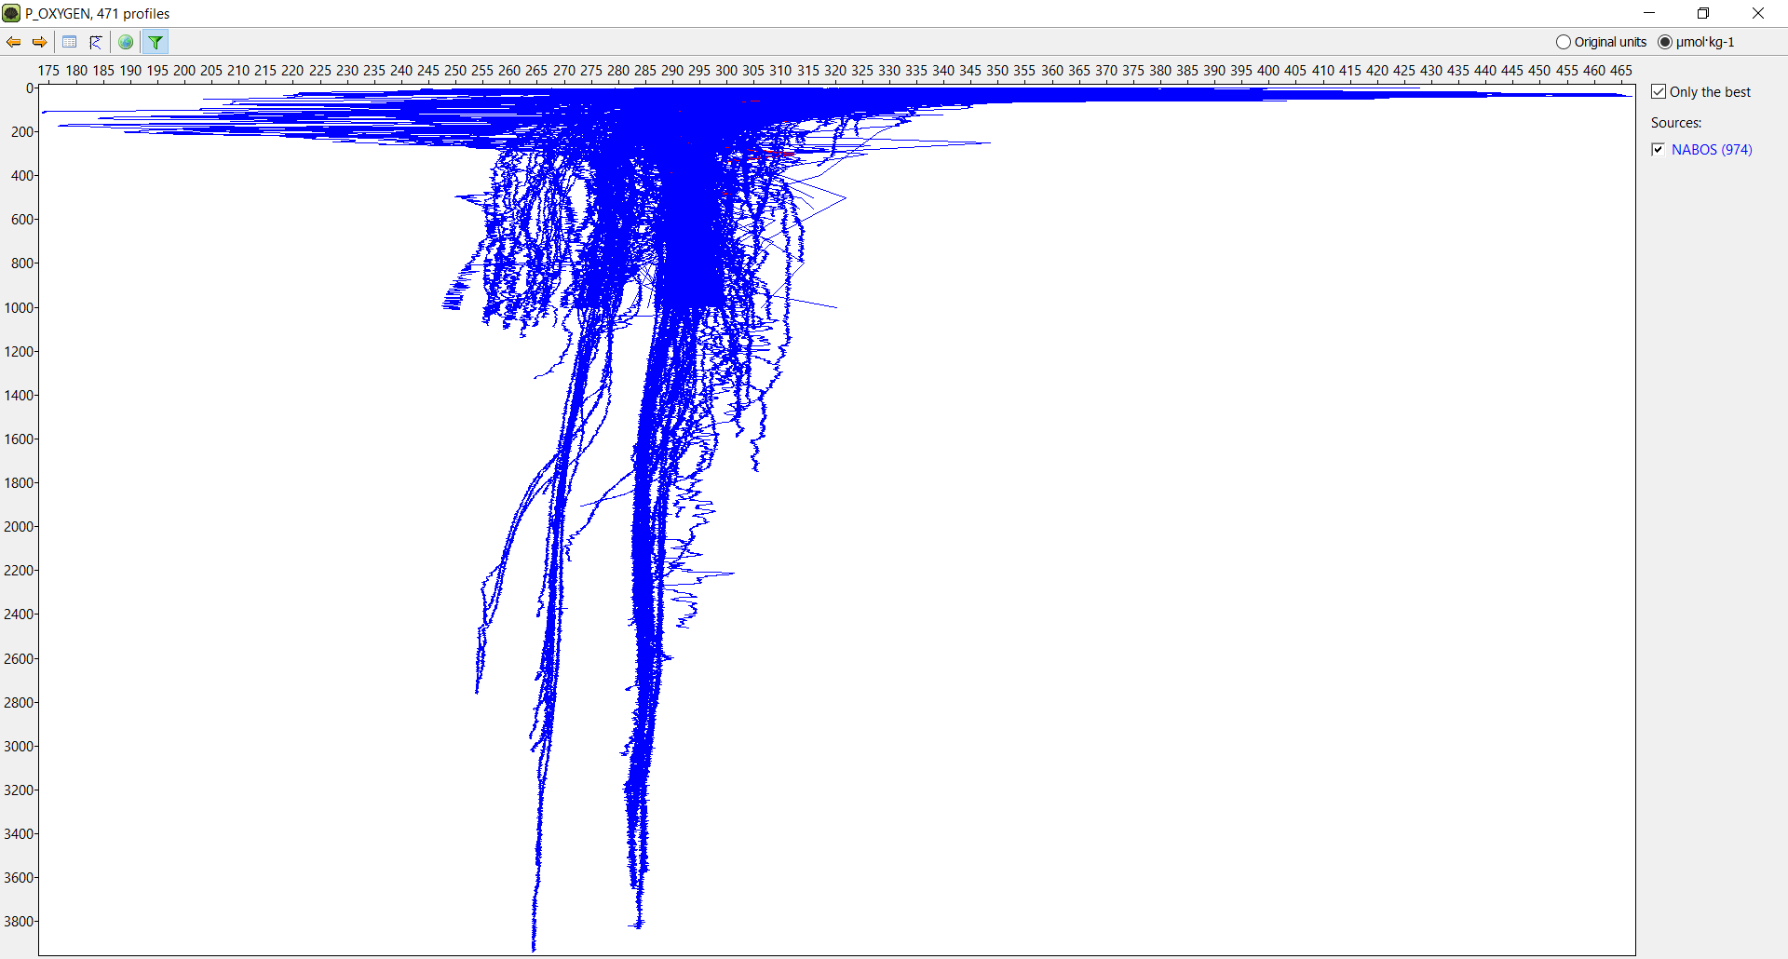
Profiles numbering at a station and station’s ‘best profile’
NABOS
Oxygen
All profiles: 974
NABOS. Example of multiple oxygen profiles from different instruments and sensors and in different units (ml/l, µmol/kg)
NABOS
Oxygen
Best profiles: 471

Slide 9
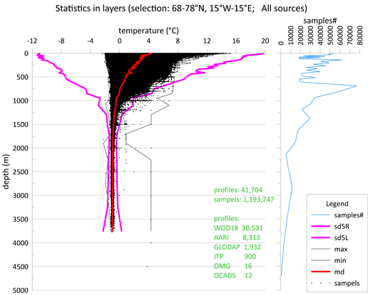
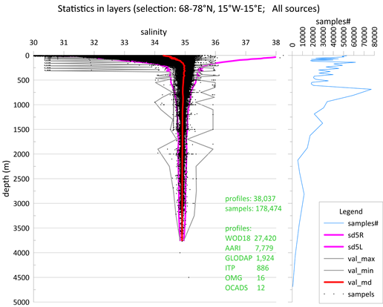
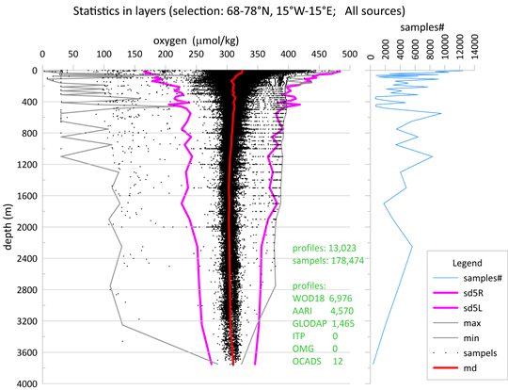
Quality control/ quality control flags
Primarily quality control
  Accepting original QC flags from DSs
  Duplicate control
  Natural ranges
  Standard deviations control in layers
  Standard deviations control in squares
  Expert control
Secondary quality control
  Crossover analysis
  Inversion analysis
Meaning of QC flags in OCEAN database
0 not checked
1 bad
2 suspicious
3 calculated
4 acceptable
5 passed primary QC
6 passed expert control
7 passed secondary QC
8 passed secondary QC and adjusted
9 not used yet

Slide 10
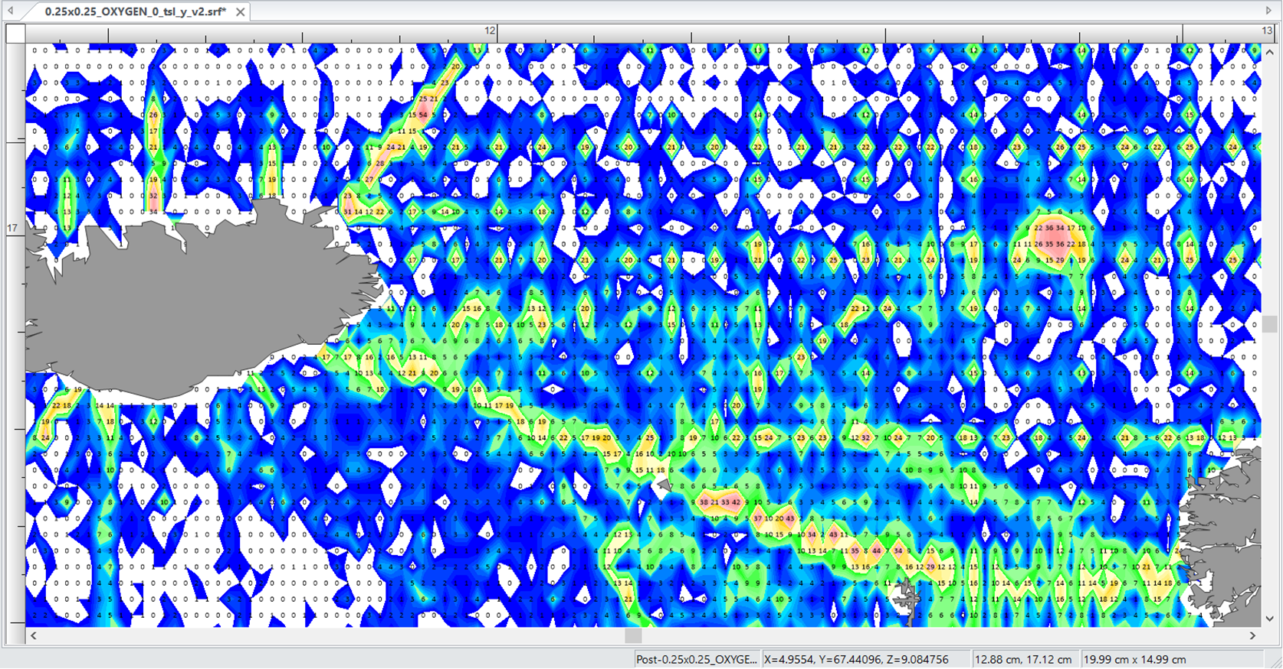
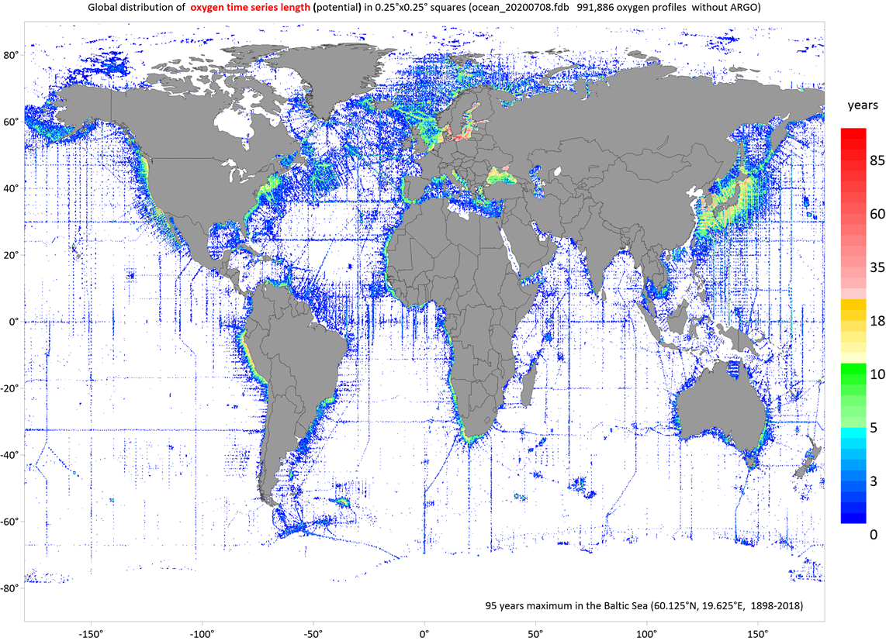
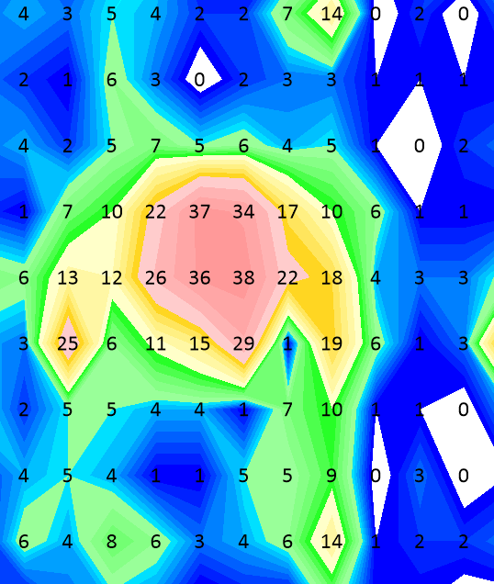
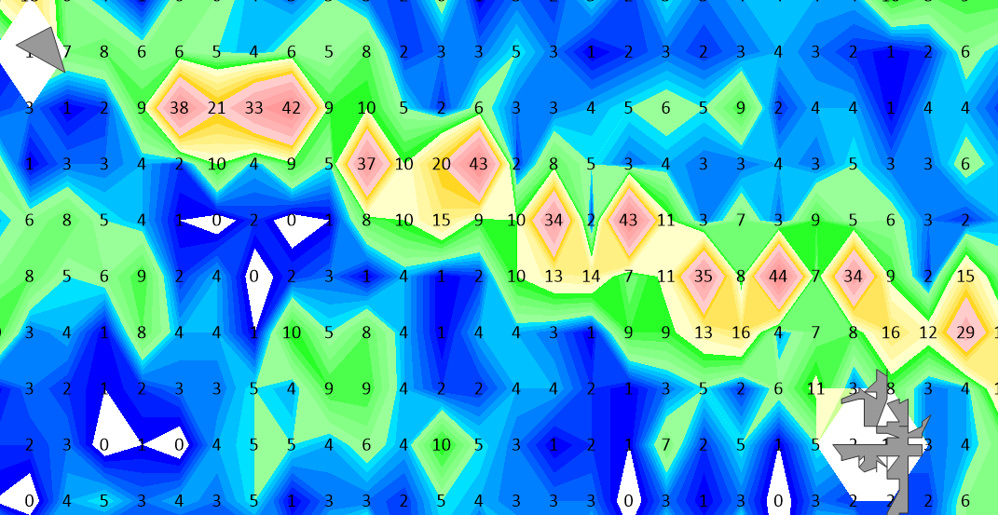
Preparing for time-series analysis (oxygen)
The Faroe-Iceland Ridge
OWS Mike in the Norwegian Sea (38 years)
Standard section in the Faroe-Shetland Strait (44 years)

Slide 11
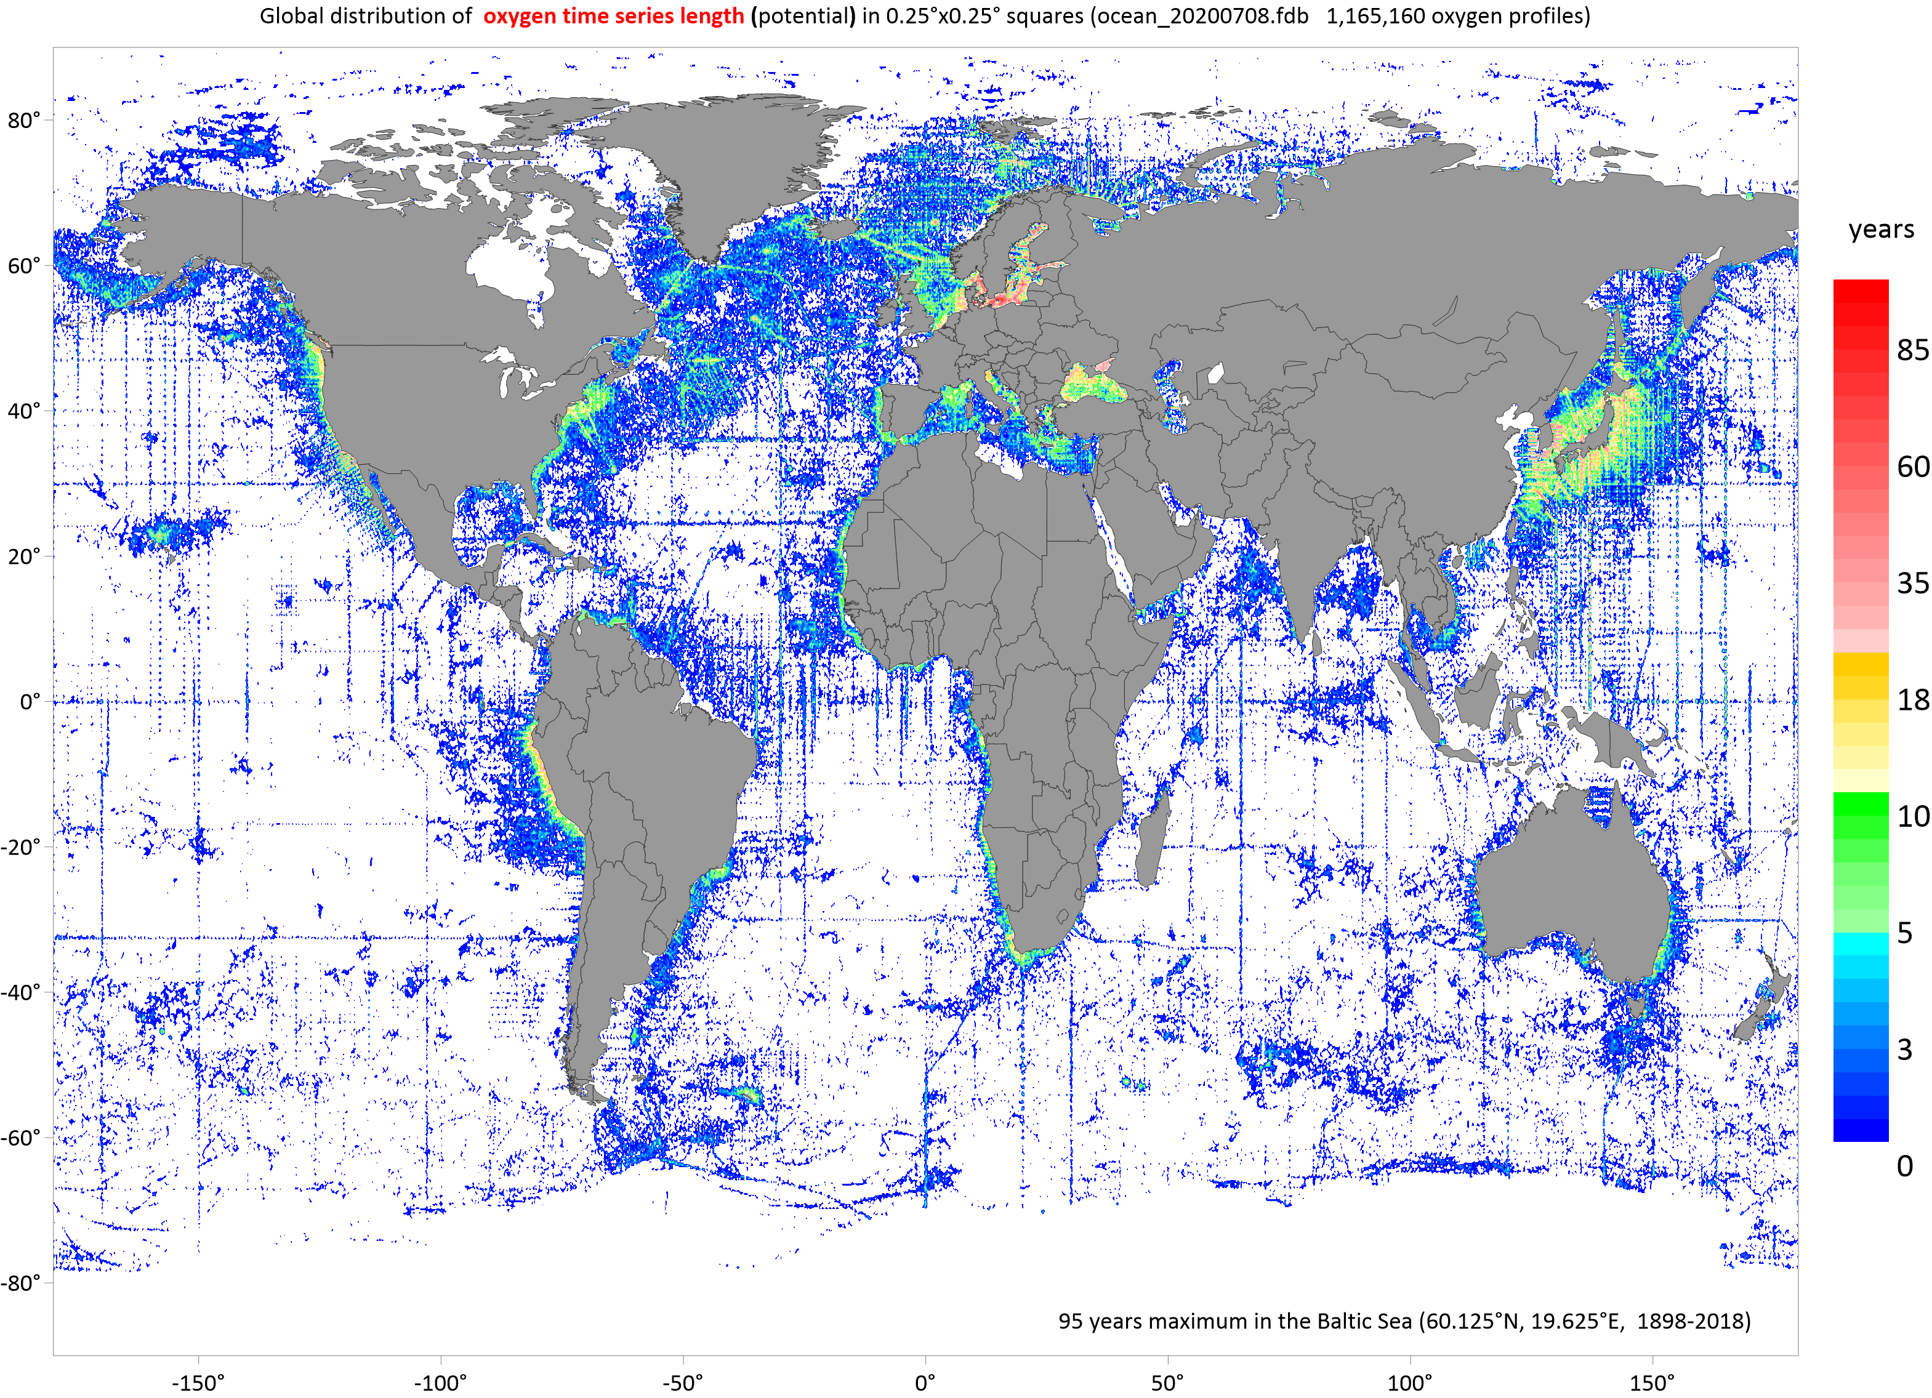
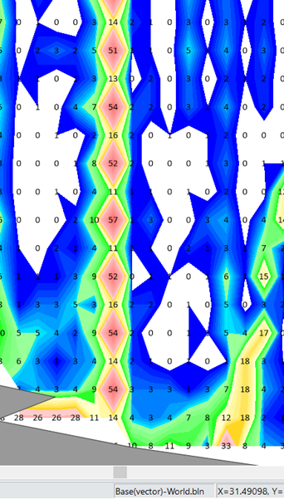
Preparing for time-series analysis (oxygen with BGC-ARGO )
Kola section in the Barents Sea (57 years)

Slide 12
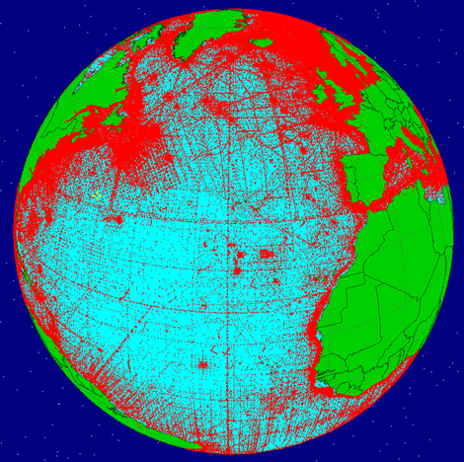
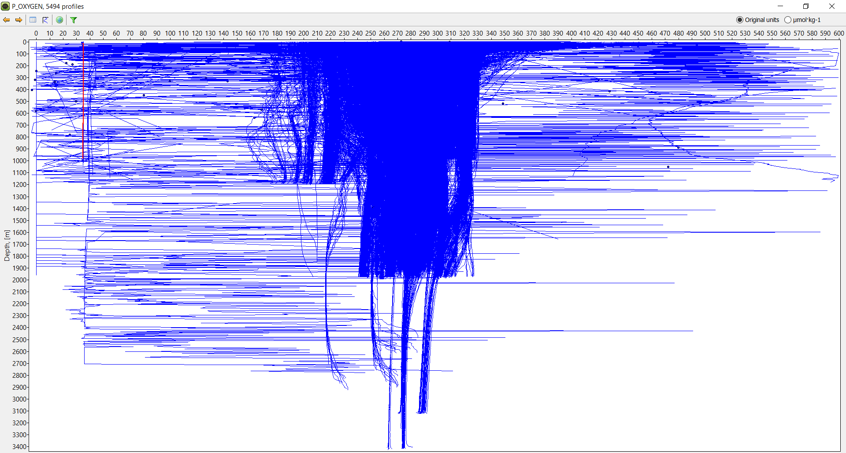
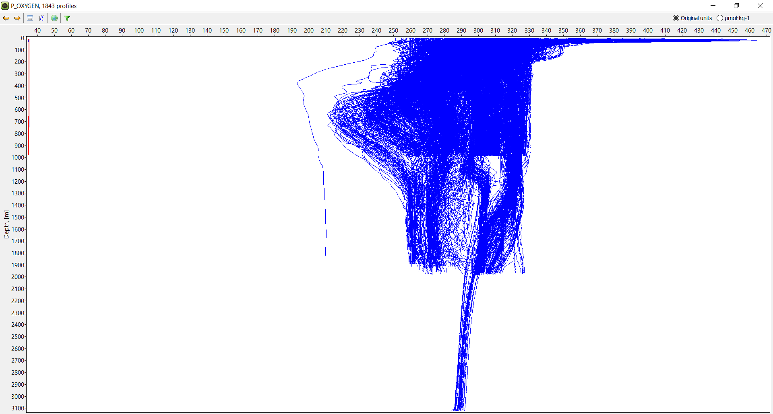

The COMFORT dataset
Text format
Variables in separate files with measurements linked to other variables and metadata by the unique IDs (no repeating information and default values)
Four QC flags: primary QC flags from a data source converted to the OCEAN database values (PQF1), primary QC flag assigned after the additional QC (PQF2), secondary QC flag (SQF, GLODAP values), PQF2 converted into WOCE system
Variables in original reported units and converted to common units (GLODAP)
BGO-ARGO real mode + delayed mode
COMFORT dataset QC flags
PQF1 (OCEAN DB values)
PQF2 (OCEAN DB values)
SQF (GLODAP values)
WOCE (WOCE values)
The Nordic Seas
PQF1 + PQF2 (ARGO / ITP)
(real time mode/ delayed mode
oxygen samples
ARGO PQF1=0 (not checked) 20,149,913
PQF1=4 (acceptable) 23,119,822
ITP PQF1=0 (not checked) 760,166
PQF1=4 (acceptable) 9,758,672
BGO-ARGO delayed mode

Slide 13
Summary
Planned data sources were uploaded into a relational data base and merged (milestone: MS6)
The database structure (firebird server v3.0) and software (Lazarus) were designed to store, process and QC complex biogeochemistry data
Quality control of the data is in the progress and the COMFORT dataset (text format) is expecting to be uploaded to common disk space at NIRD at the end of September

