Slide 1
Aqua
opts.fileName = 'no_file.tif';
opts.minSize = 8;
opts.smoXY = 0.5000;
opts.thrARScl = 2;
opts.thrTWScl = 2;
opts.thrExtZ = 1;
opts.cDelay = 2;
opts.cRise = 2;
opts.gtwSmo = 1;
opts.maxStp = 11;
opts.zThr = 2;
opts.ignoreMerge = 1;
opts.mergeEventDiscon = 0;
opts.mergeEventCorr = 0;
opts.mergeEventMaxTimeDif = 2;
opts.regMaskGap = 5;
opts.usePG = 1;
opts.cut = 200;
opts.movAvgWin = 25;
opts.extendSV = 1;
opts.legacyModeActRun = 1;
opts.getTimeWindowExt = 50;
opts.seedNeib = 1;
opts.seedRemoveNeib = 2;
opts.thrSvSig = 4;
opts.gapExt = 5;
opts.superEventdensityFirst = 1;
opts.gtwGapSeedRatio = 4;
opts.gtwGapSeedMin = 5;
opts.cOver = 0.2000;
opts.minShow1 = 0.2000;
opts.minShowEvtGUI = 0;
opts.ignoreTau = 1;
opts.correctTrend = 1;
opts.extendEvtRe = 0;
opts.propthrmin = 0.2000;
opts.propthrstep = 0.1000;
opts.propthrmax = 0.8000;
opts.frameRate = 1 / ts.dt / merge_frames;
opts.spatialRes = ts.dx;
opts.varEst = 0.0053;
opts.fgFluo = 0;
opts.bgFluo = 0;
opts.northx = 0;
opts.northy = 1;
opts.skipSteps = 1;
Aqua doesn’t work well on 30 Hz.
Good results after resampling to 3 Hz.
Used multiple processes to speed up around 2x / 3x.
283 tseries in wt dataset took about 5 days.
Can give aqua data to Celine.
Type | Frames | Event Number | Running Time (s)
thrARScl 2, 3 Hz | 1786 | 37186 | 3h 29m
thrARScl 3, 3 Hz | 1786 | 8812 | 1h 13m

Slide 2
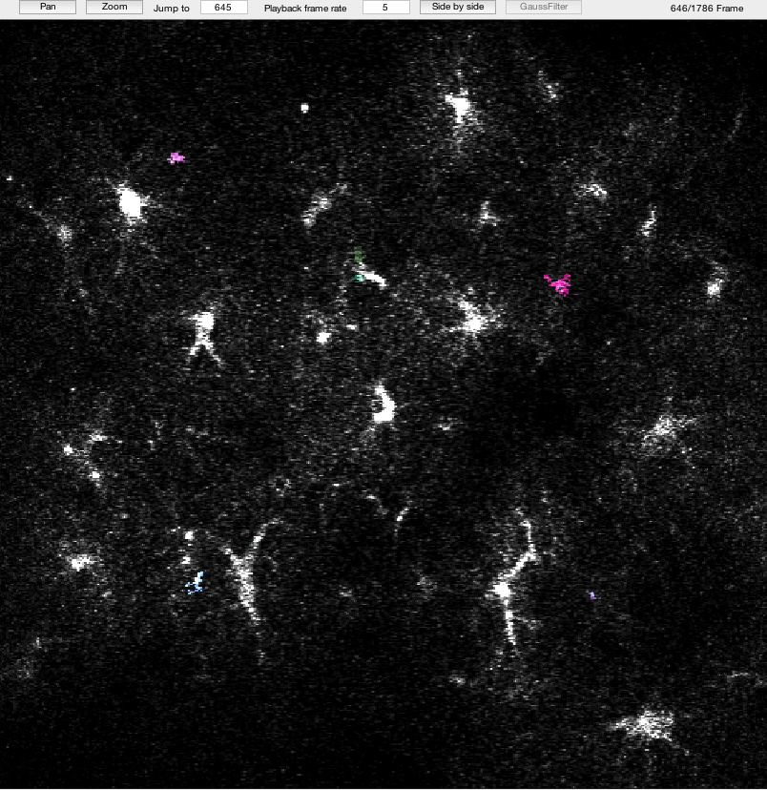
Aqua
3Hz default param except
threshold = 3

Slide 3
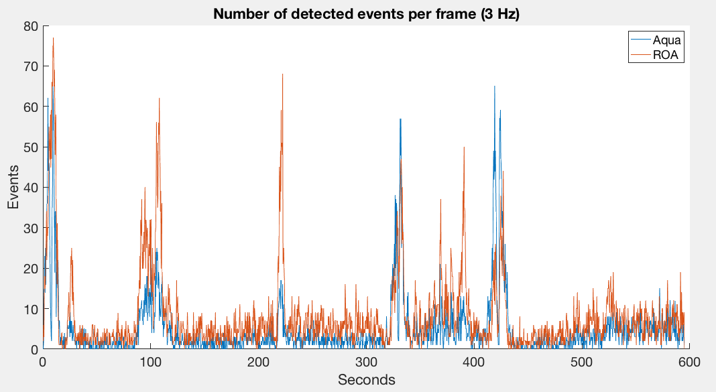
ROA Frequency trace comparison
Aqua: 8812 events
ROA: 14613 events
Correlation 0.6757

Slide 4
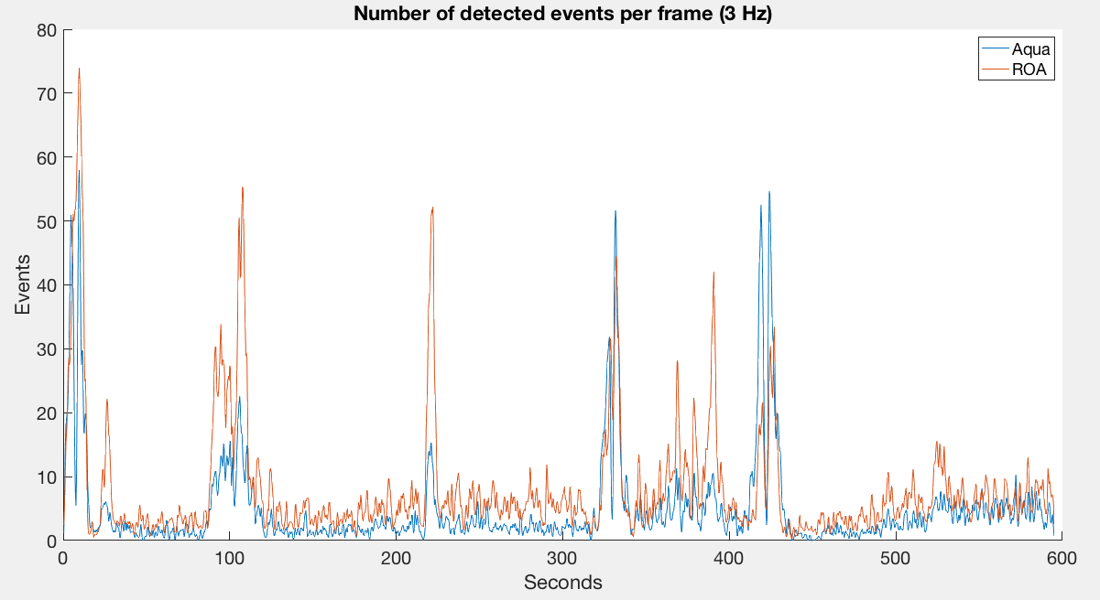
Smoothed
Correlation 0.7254

Slide 5
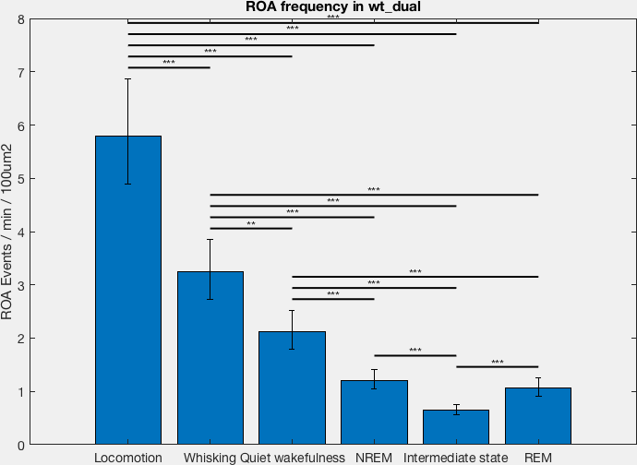
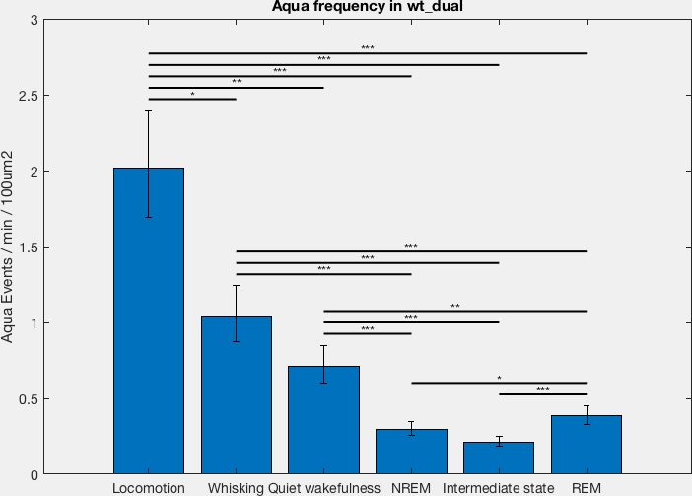
ROA vs Aqua

Slide 6
Overlap of heatmaps
Overlap between different states:
  We have 1 heatmap per FOV and state.
  i.e. episodes from the same state have been merged.
  We then calculated the overlap between states in the same FOV.
Overlap between the same state (e.g. NREM to NREM):
  For each FOV and state I have created 2 heatmaps.
  The first heatmap is created from merging the first half of the episodes.
  The second heatmap is created from merging the second half of the episodes.

Slide 7
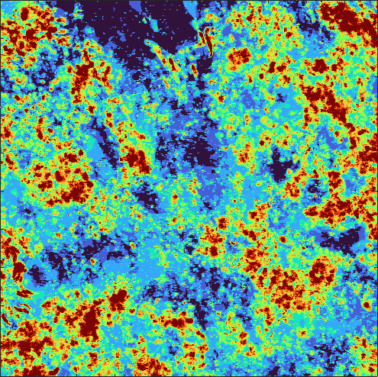
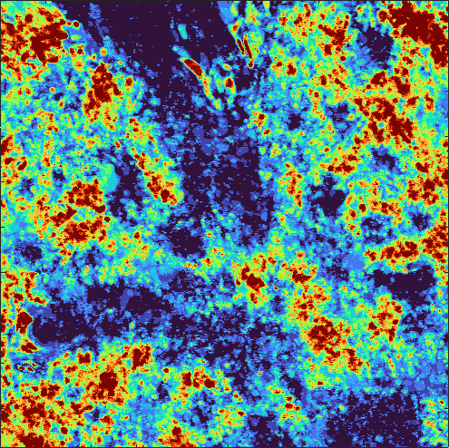
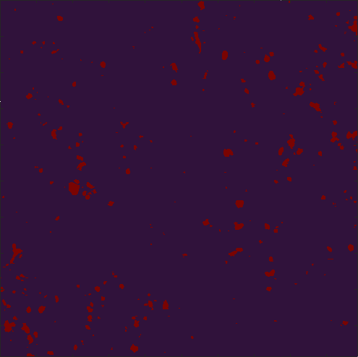
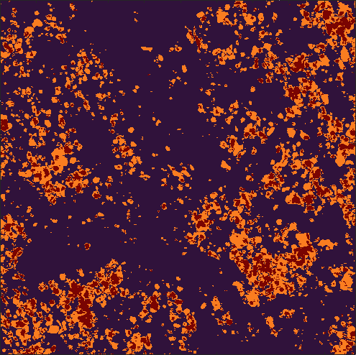
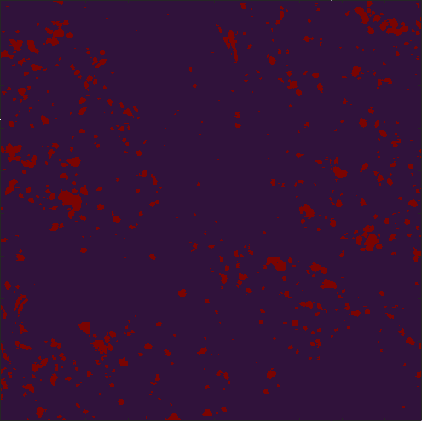
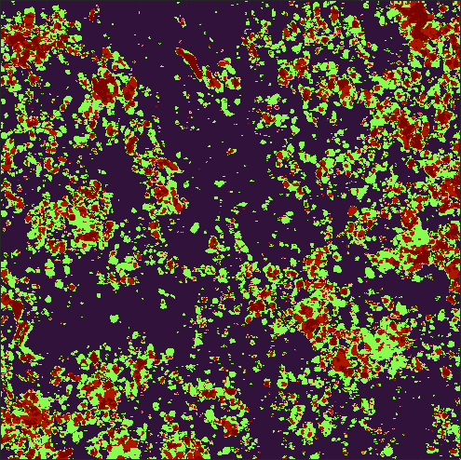
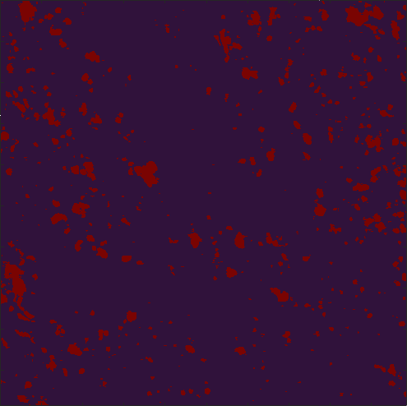
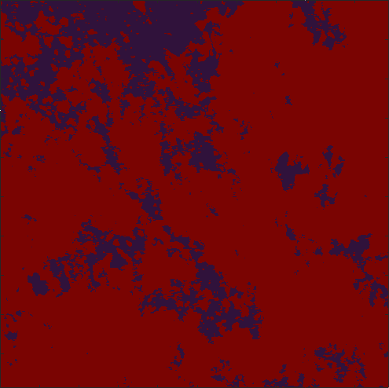
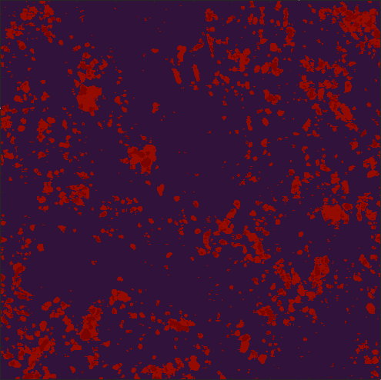
Example:
Locomotion episodes into 2 heatmps
64s
120s
9s
40s
13s
64s
10s
15s
31s

Slide 8
Overlap of heatmaps
The duration of the heatmaps seems very important for the results.
In general the correlation increases with increasing durations.
Locomotion to Locomotion correaltion 0.37

Slide 9
NREM / IS frequency in wt / ip3
Genotype | NREM to Wake Frequency | IS to Wake Frequency | NREM to IS Frequency | IS to NREM Frequency
Ip3 | 1.78 per hour | 3.69 per hour | 4.09 per hour | 0.93 per hour
Wt | 1.89 per hour | 4.72 per hour | 1.91 per hour | 0.79 per hour

Slide 10
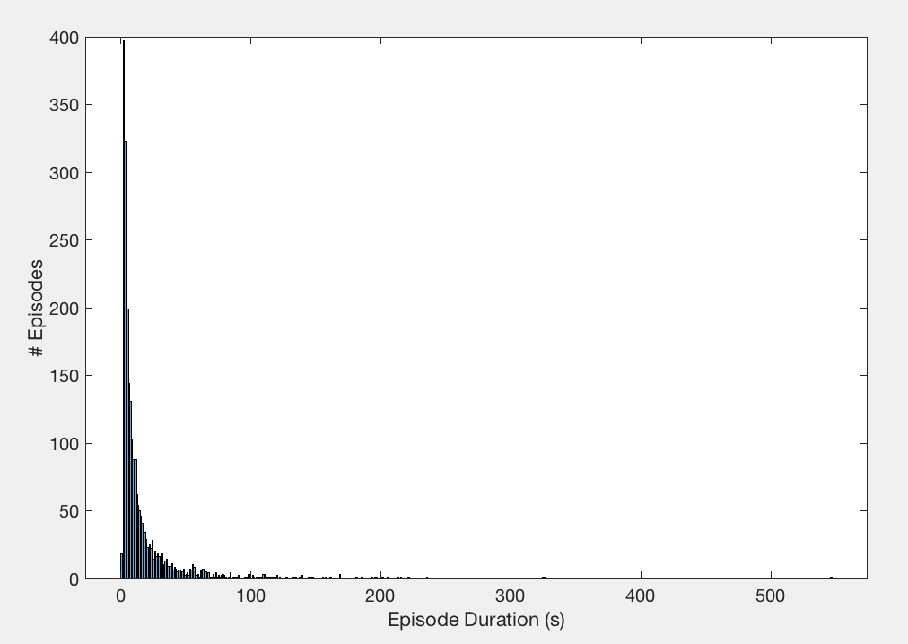
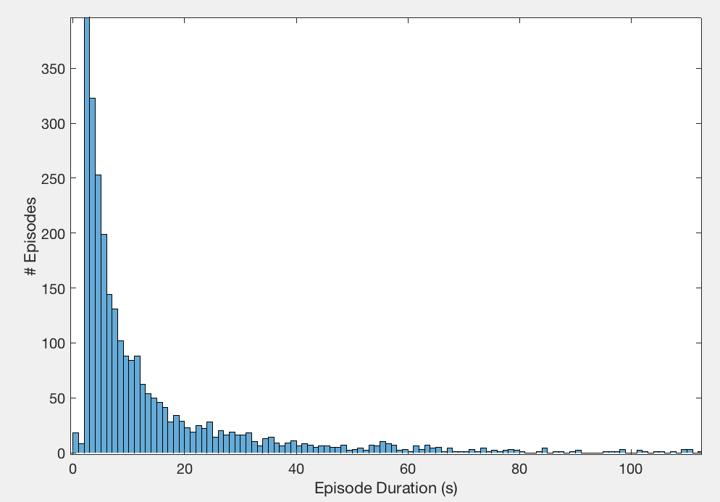
Quiet wakefulness lower than 5 seconds
The 3 last seconds at the end of quiet is (still) removed.

