Slide 1
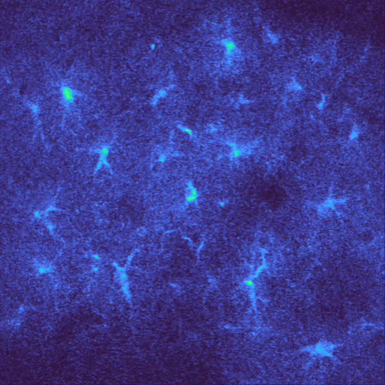

Slide 2
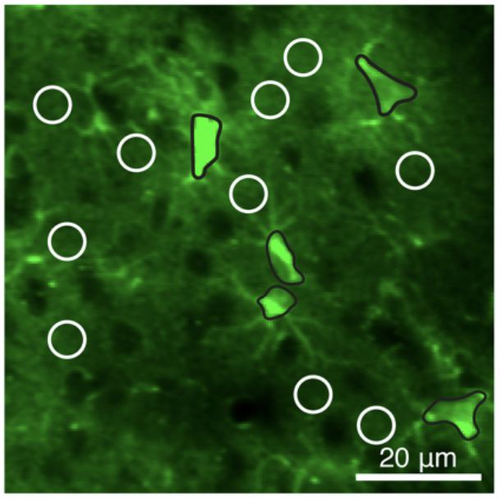
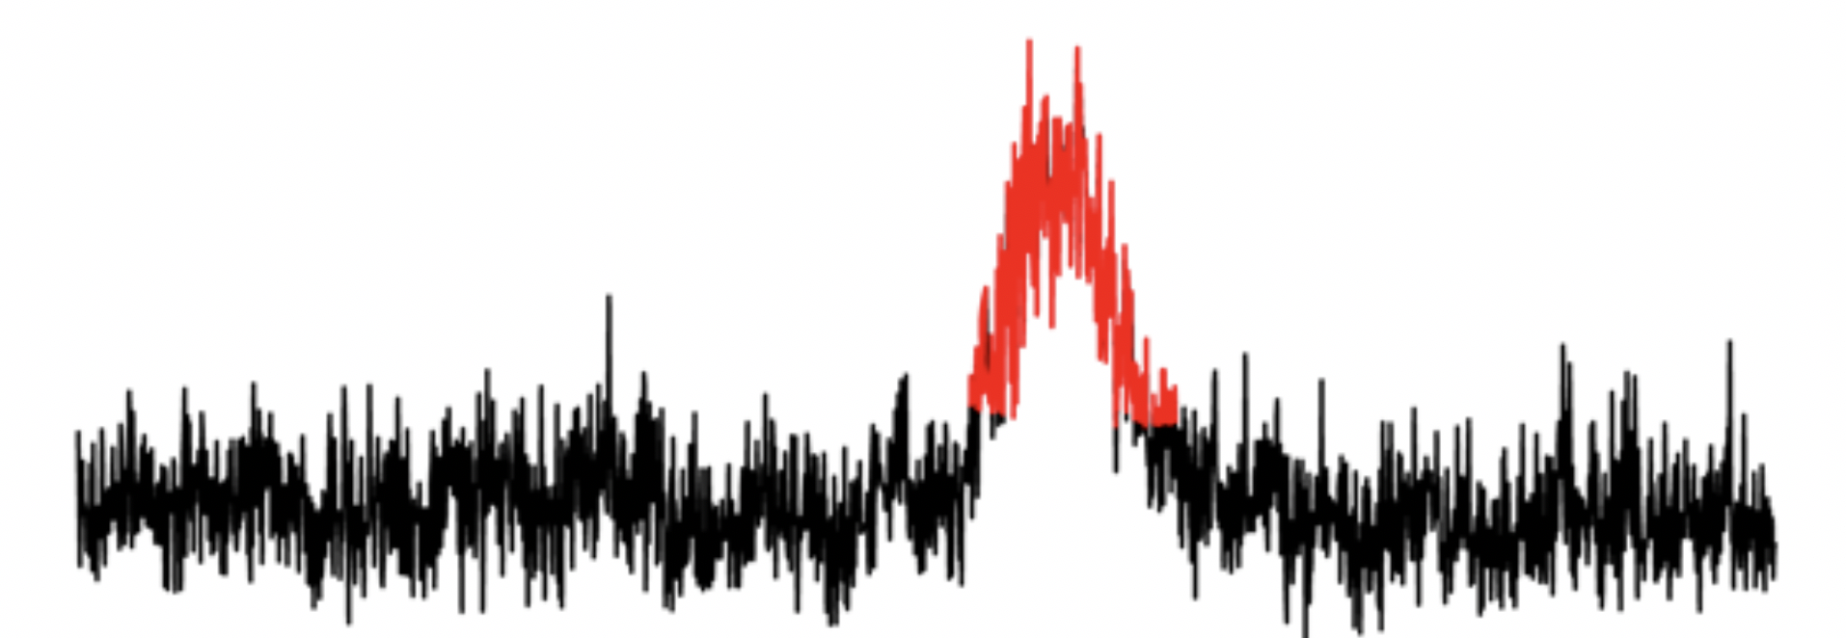
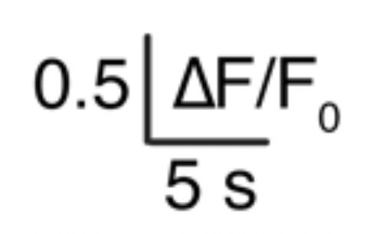
ROI timeseries

Slide 3
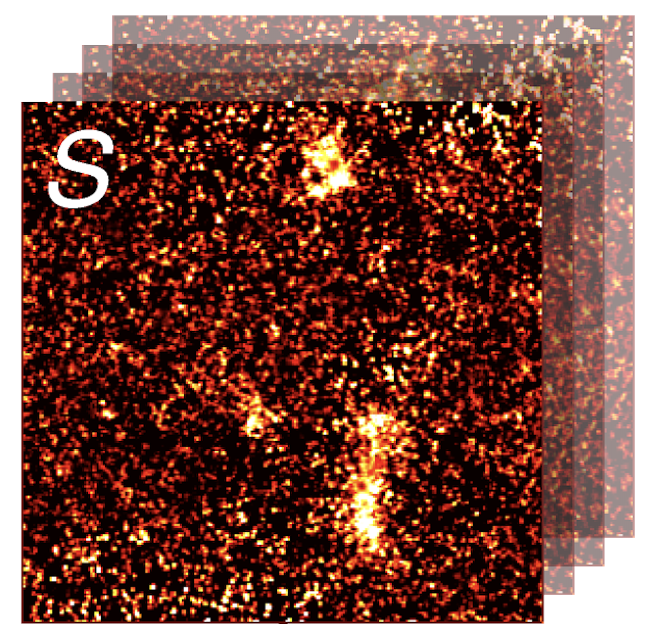
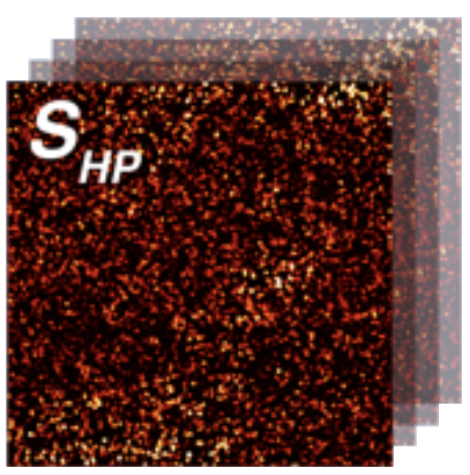
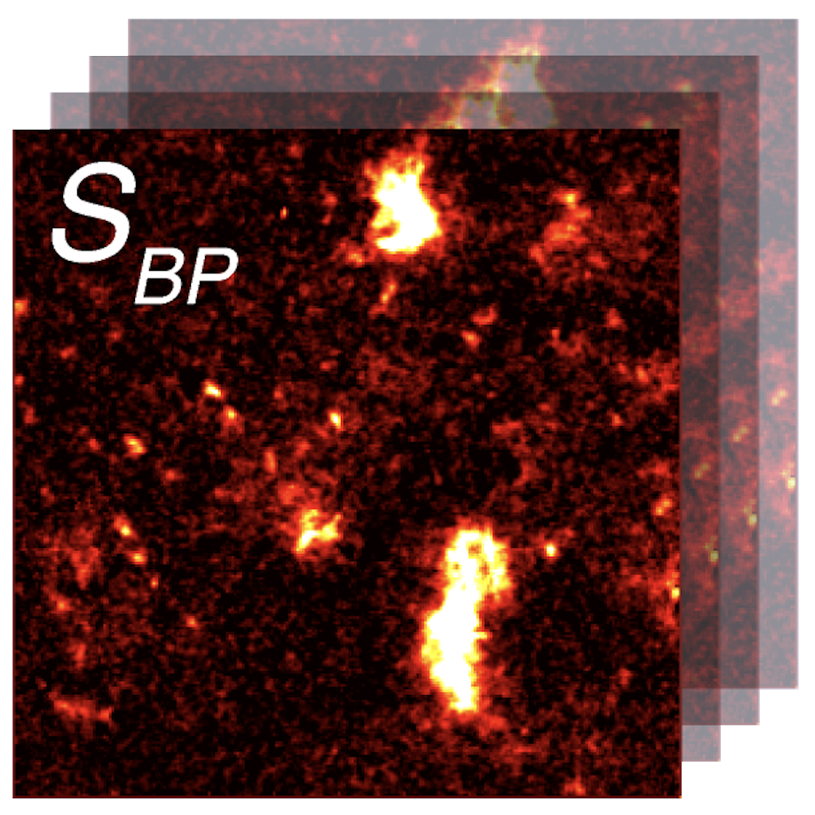
Notes:
To repeat, if we apply the same steps to the calcium images, it will look something like this
Separate a noise and signal version

Slide 4
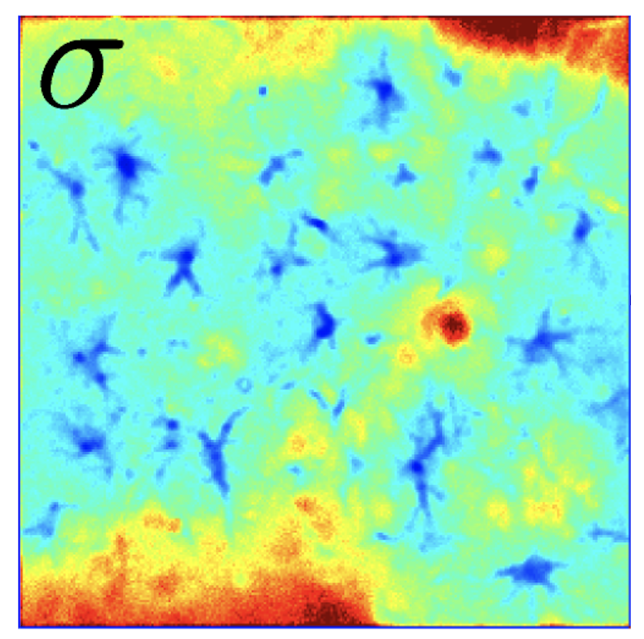
Notes:
Calculate an approximation of the noise variance, sigma, producing an image with the standard deviation values.

Slide 5
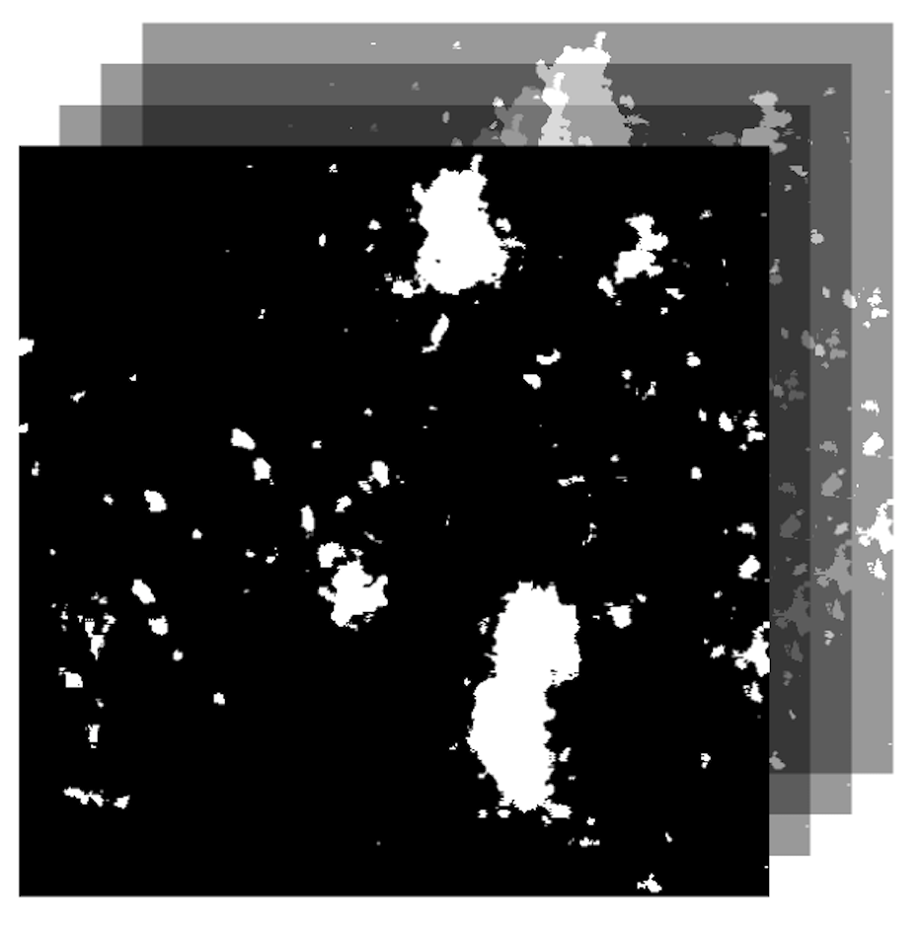
Notes:
When then threshold the smoothed image, top image, with the noise image, which produces a new image with the calcium events outlined as you can see here. This is done for each frame which gives us a video of the calcium events.

Slide 6
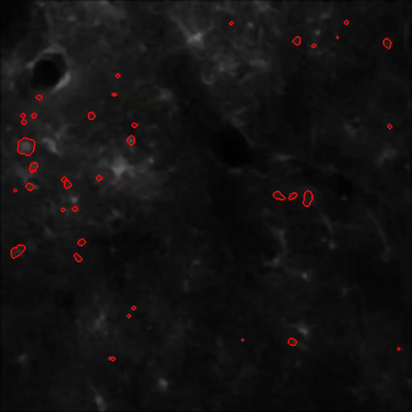

Slide 7
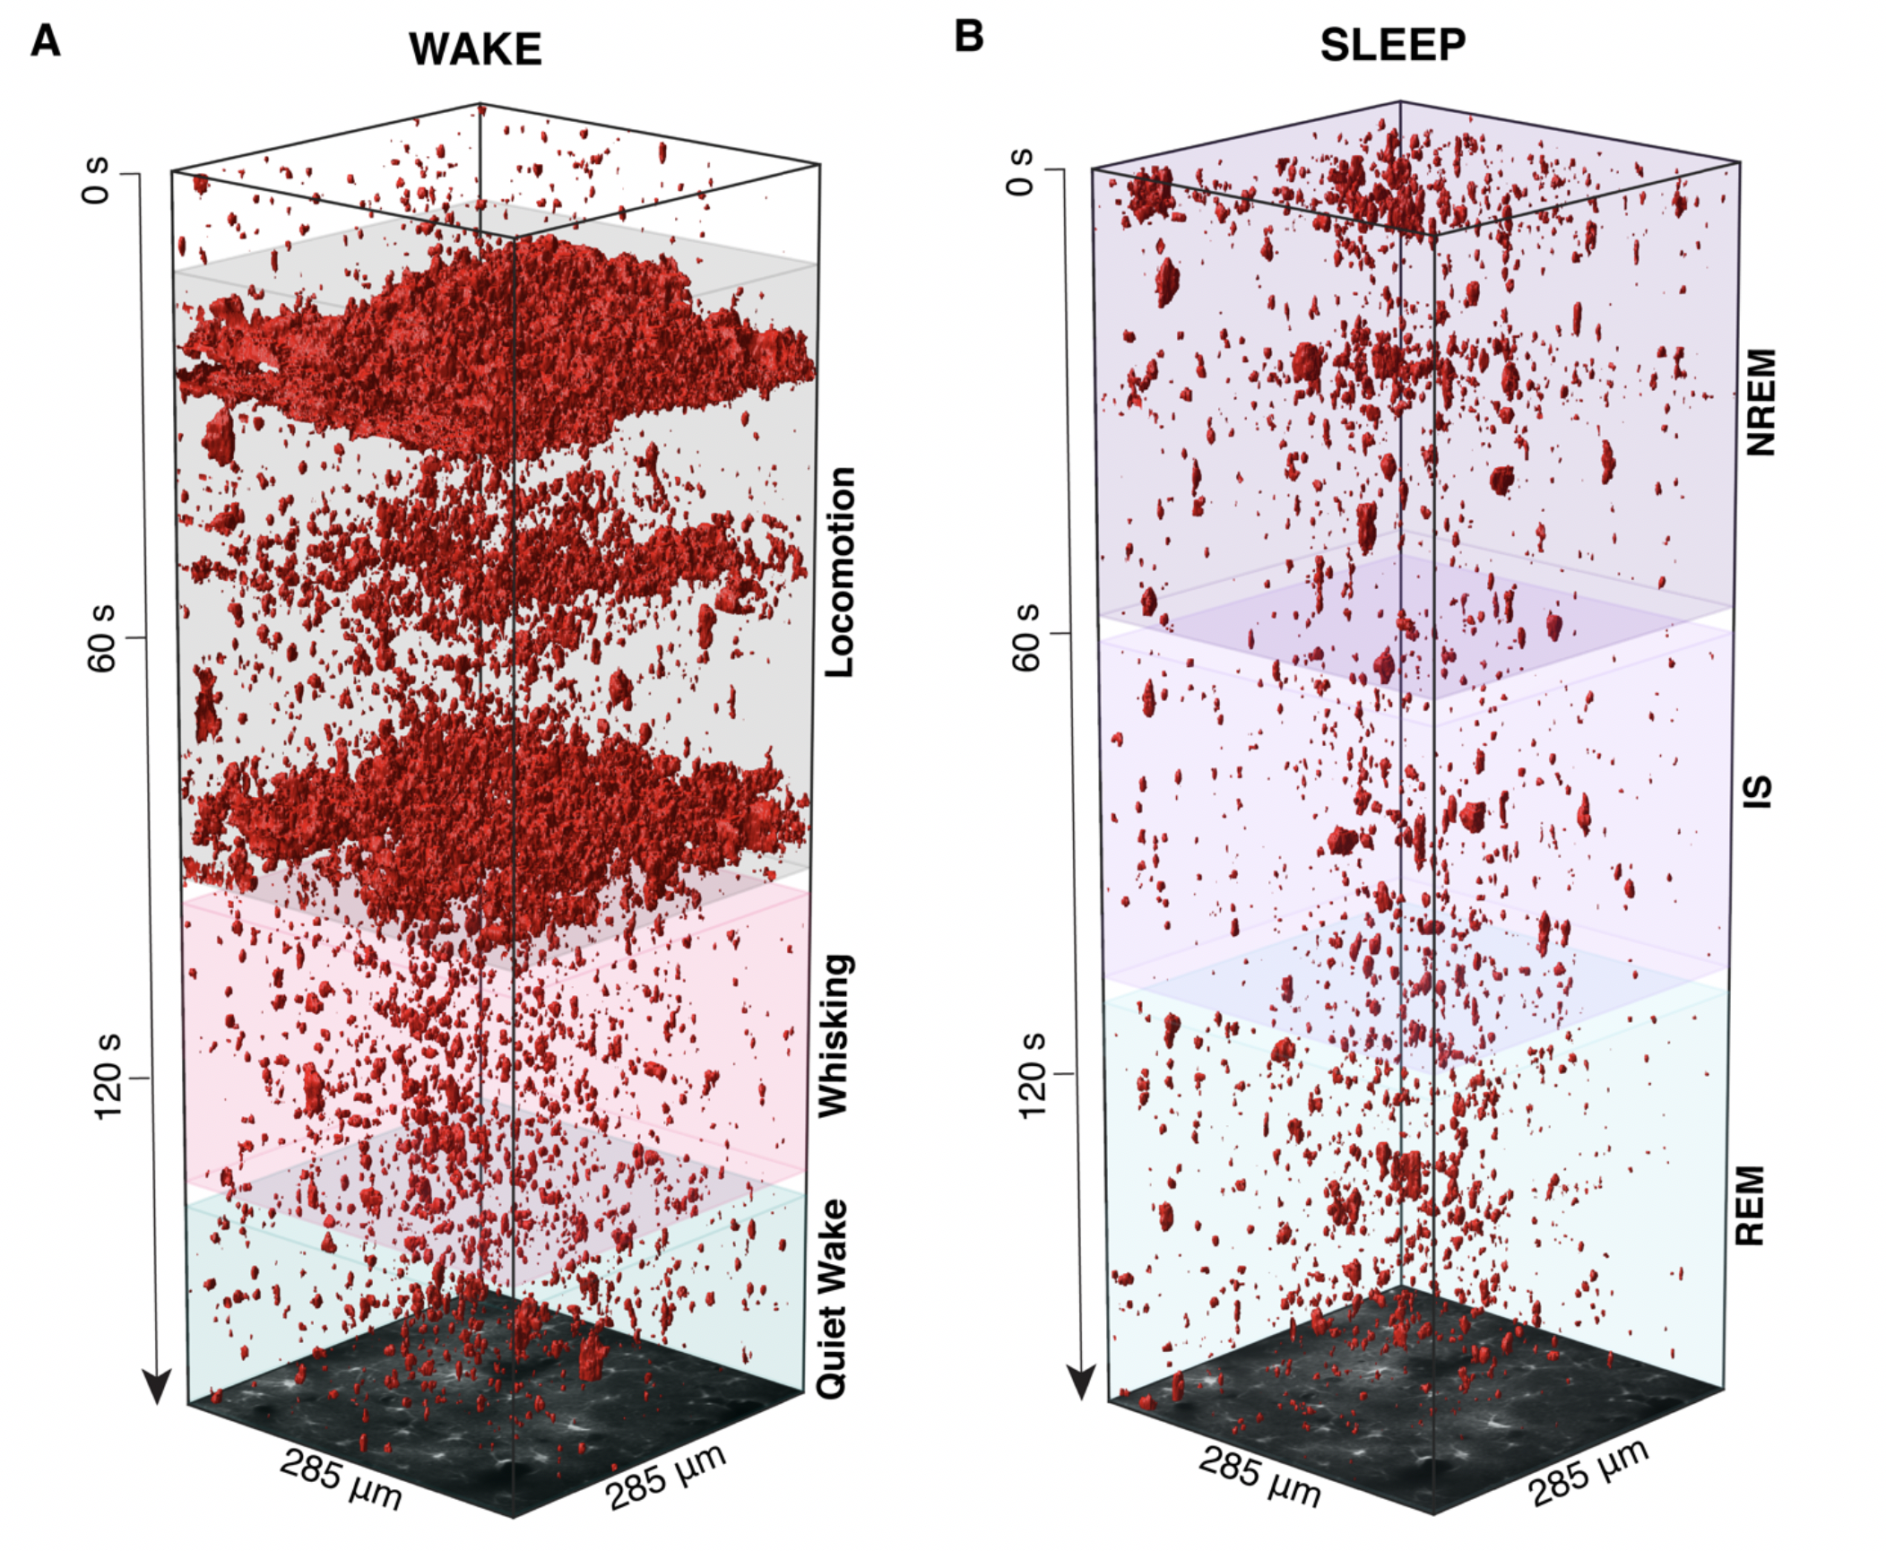
Notes:
These processed videos can then be visualized into pretty cool 3D representations
Here we have time along the z-axis and neighboring active pixels in time and space are outline in red.
We have used the ROA algorithm to study calcium signals in awake and sleeping mice.

Slide 8
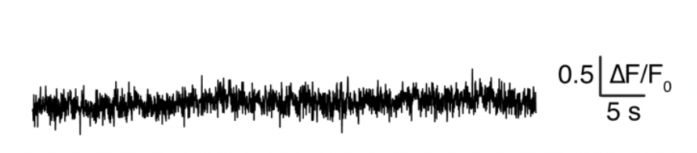
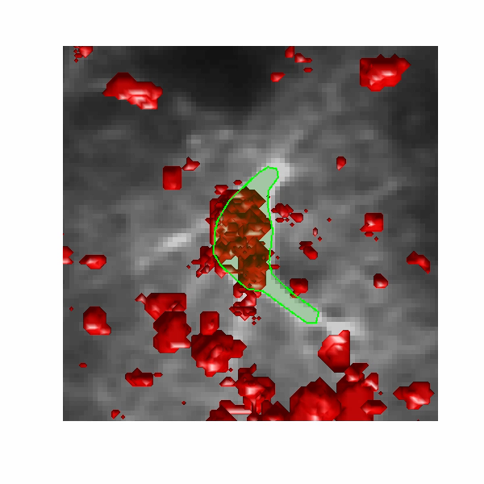
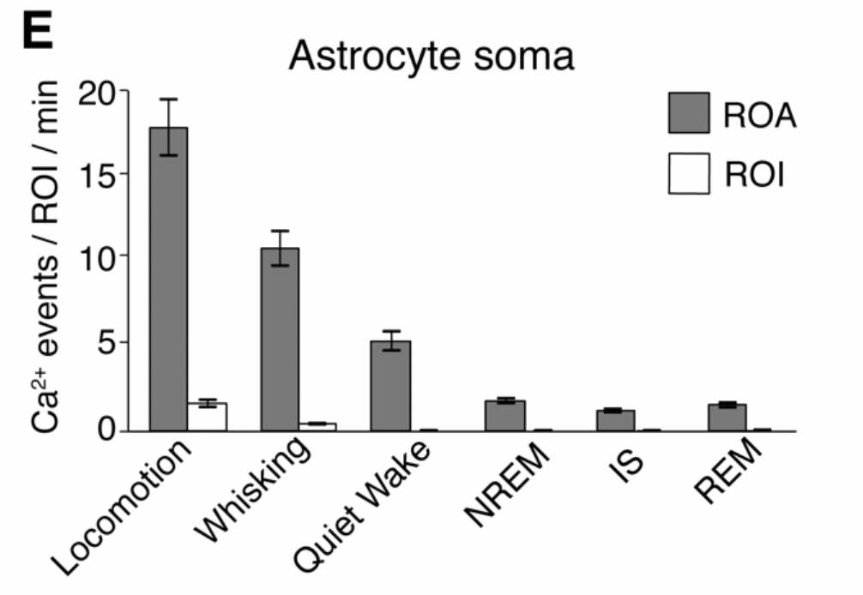
Comparison to ROIs
Soma ROI fluorescence
Notes:
In addition, this way of analyzing the data seems to be more sensitive than methods we have used before.
As you can see, if we just look at the timeseries from a regular ROI the activity is not clear. But by using our ROA algorithm, we see that the calcium events vary in location and gives us a much richer signal than we can detect with the ROI.
As a further analysis of this we measured how many events we detected inside the ROI vs our ROA method.

